Slide 1
Finding Nemo:
Fiction or Reality?
Assessing the biogeographical accuracy of the film Finding Nemo
Emily Kroft, Étienne Lacroix-Carignan, Jenna LeBlanc, Amanda Liczner, and Indigo Tran
Notes:
Indigo: Hello, welcome to our final project presentation.
While we are proud of the work we have done here and we wholeheartedly support this course, We ask that you don’t live tweet about our presentation, since we believe that there are more important conversations going on on social media and we don’t want to dilute black voices in and outside of science. Please reach out to us at the end for more information instead.
Now, we will be talking about the movie Finding Nemo and whether or not it is bio-geo-graphically accurate.

Slide 2
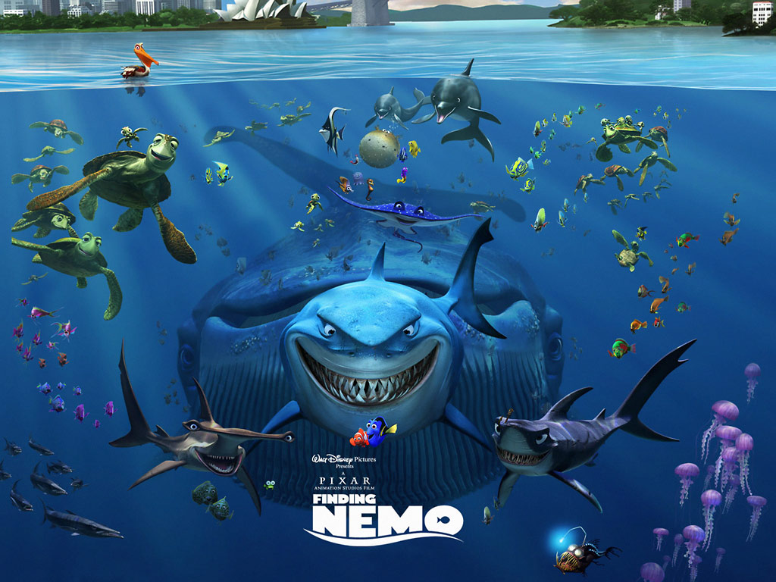
Our Conclusion:
While most of the species assemblages shown in the film are accurate, there are several significant geographical inaccuracies
B
Notes:
Jenna: In order to grab your attention we want to start our presentation with our results, which are: insert slide text here. So overall, we give this movie (click-1) a solid B. And we will now walk you through how we arrived at this conclusion. (click-2)

Slide 3
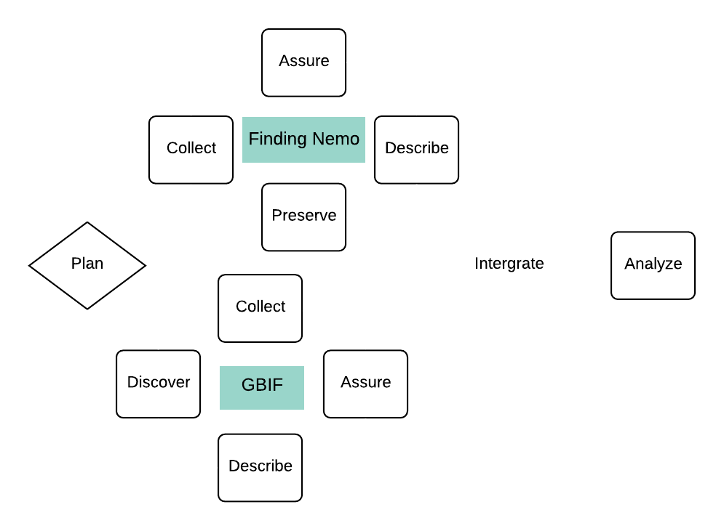
Our Data Life Cycle
Two simultaneous cycles for processing data from two different data sources
Integrate
Notes:
Jenna: we wanted to map our data life cycle through the process of putting this project together, and discovered that essentially had two separate data cycles running simultaneously; one for each main source of data we were handling. We then integrated the processed data from each source and analyzed the combined results. We’re going to walk through our data life cycle to show how we arrived at our aforementioned conclusion. (next slide-click)

Slide 4
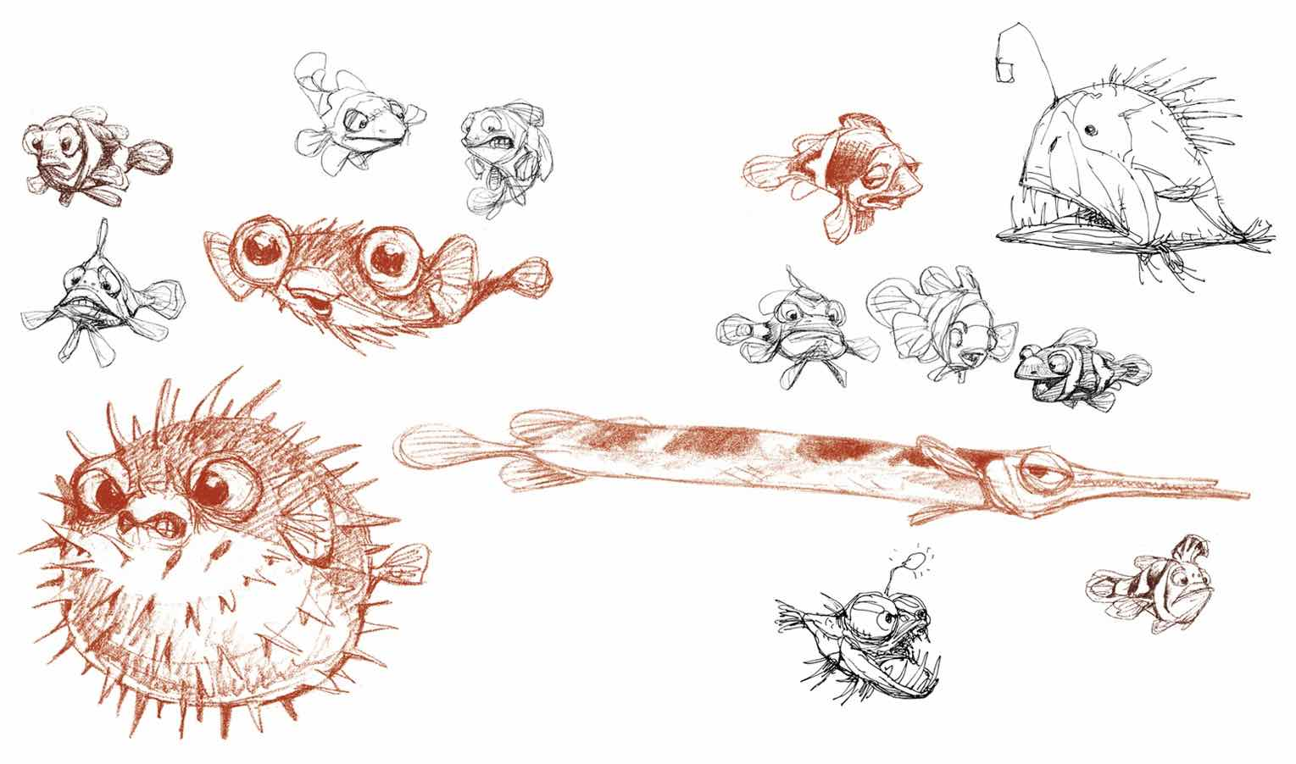
Planning
Why Finding Nemo?
Depicts a real-world ecosystem
Familiar and accessible
Well-researched
Notes:
Jenna: The first step of our project was figuring out which piece of media we wanted to analyze for biogeographical accuracy.
We decided on Finding Nemo, because it:
depicts a real-world ecosystem (coral reefs and the ocean off the coast of Australia)
Is familiar and accessible to most people
Is well-researched. The animators working on the film actually audited marine biology classes and took scuba lessons in preparation for the film

Slide 5
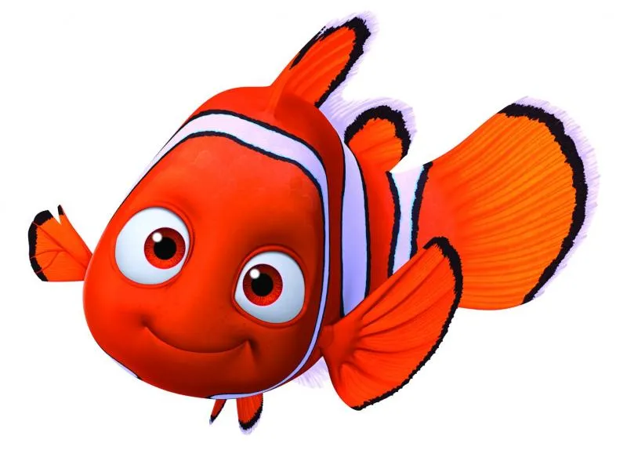
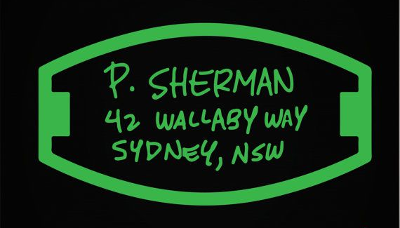
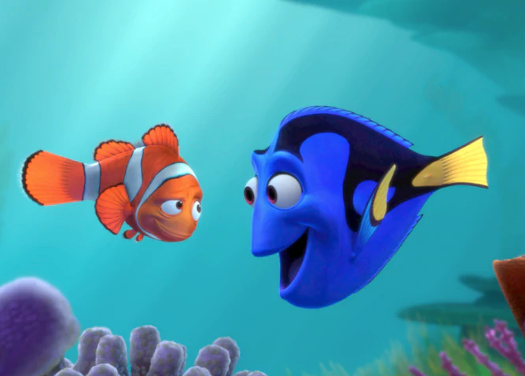
Planning
How to define biogeographical accuracy?
Are “real” species depicted?
2. Do they occur in accurate locations?
3. Do they co-occur in realistic assemblages?
Notes:
Jenna: the next step was to figure out how we would define biogeographical accuracy. We decided to focus on three main research questions:
If the species depicted in the movie are “real species”, or just generic cartoon fish
If the species are real, do they occur where they would in real life?
Are the species occurring together in assemblages you would find in the real world, or are they forced together for the sake of the story?
Once we had established a plan, we had to go about collecting data to test these research questions. I’ll pass it over to Etienne to explain how we did that

Slide 6
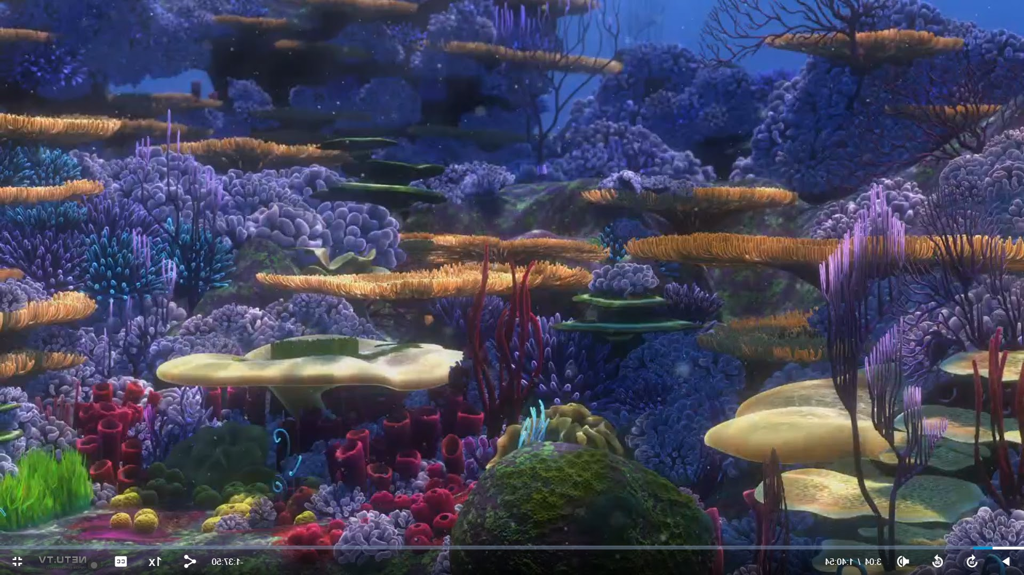
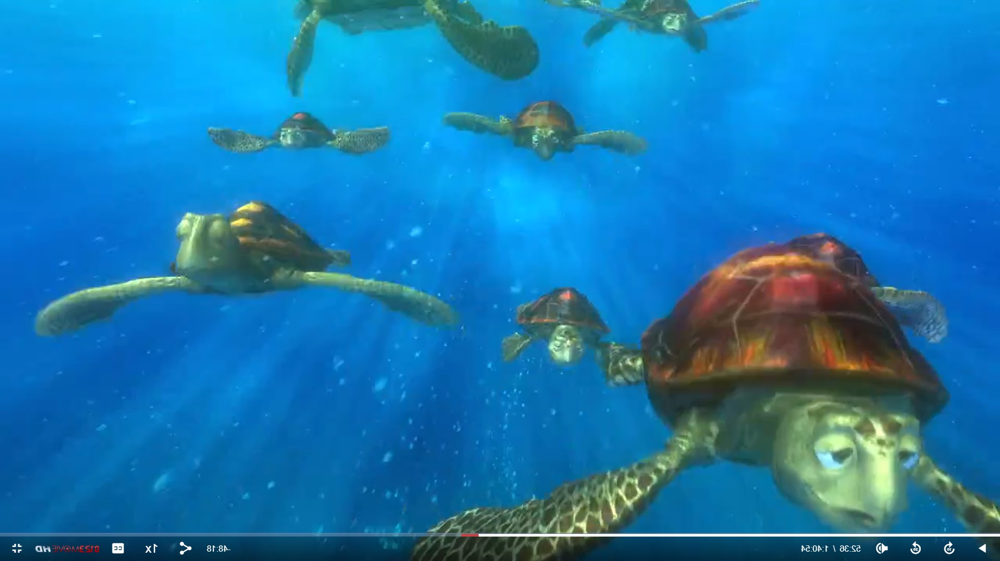
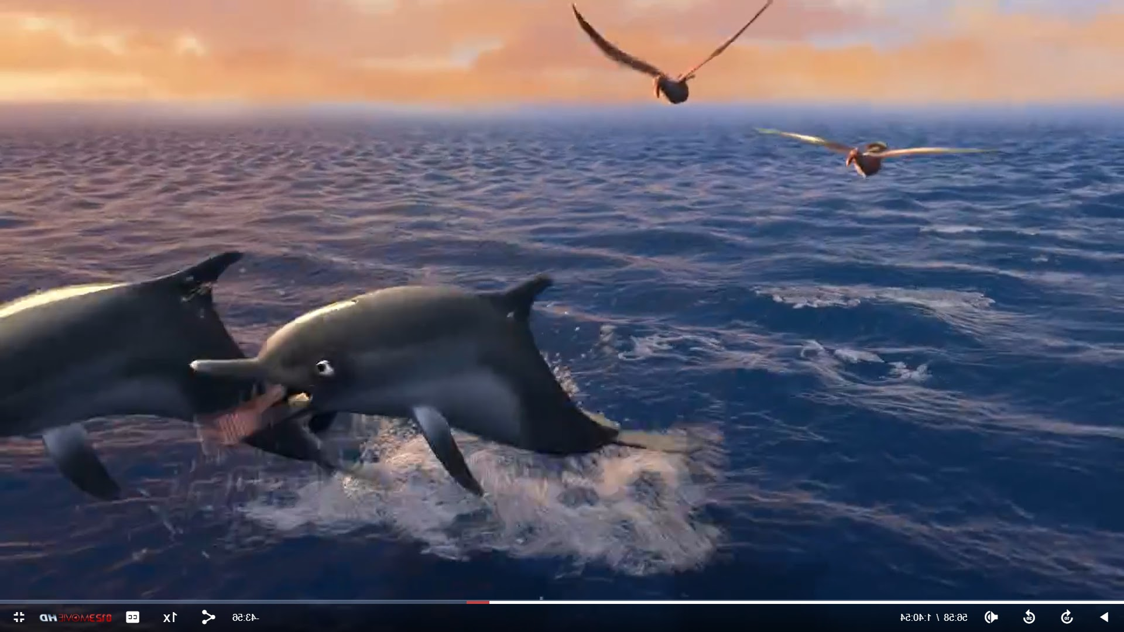
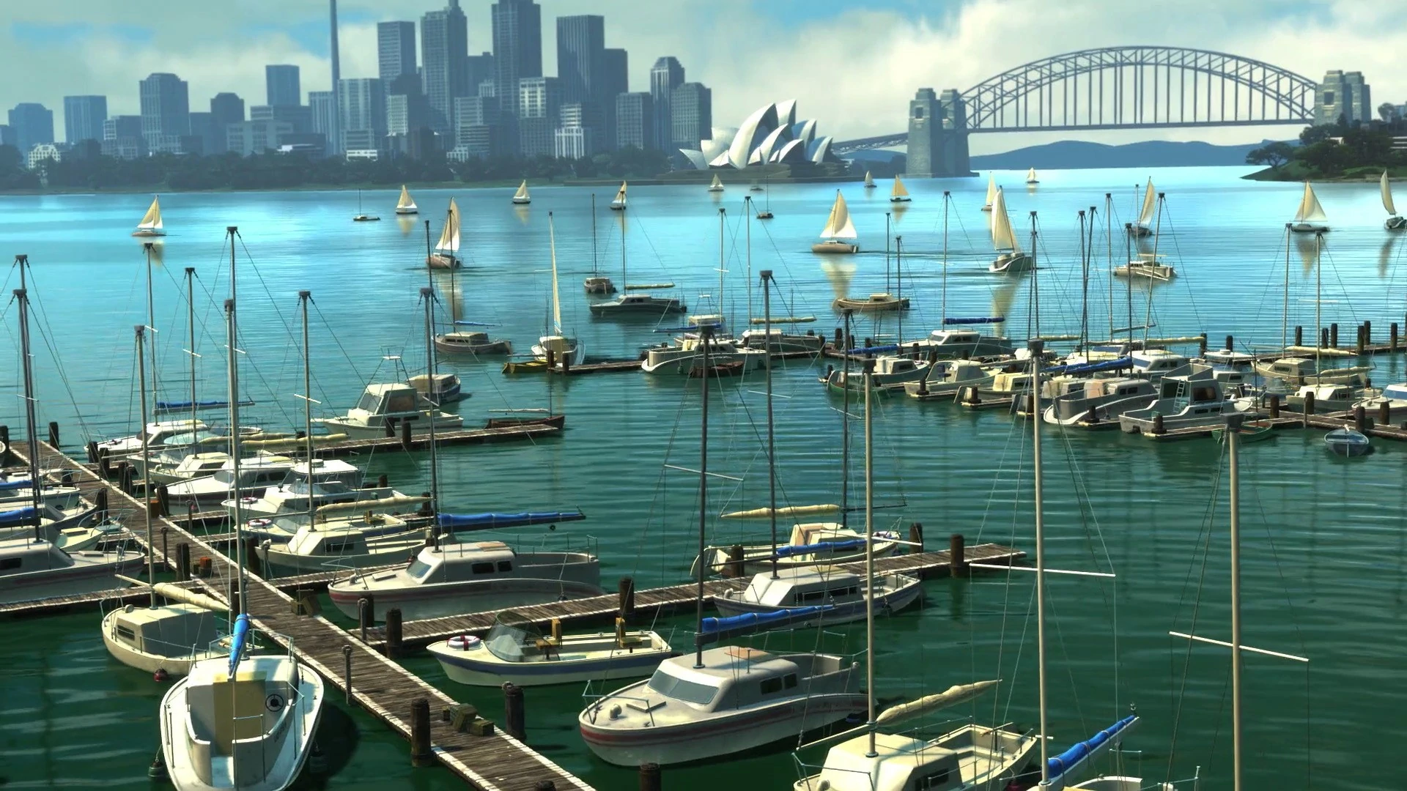
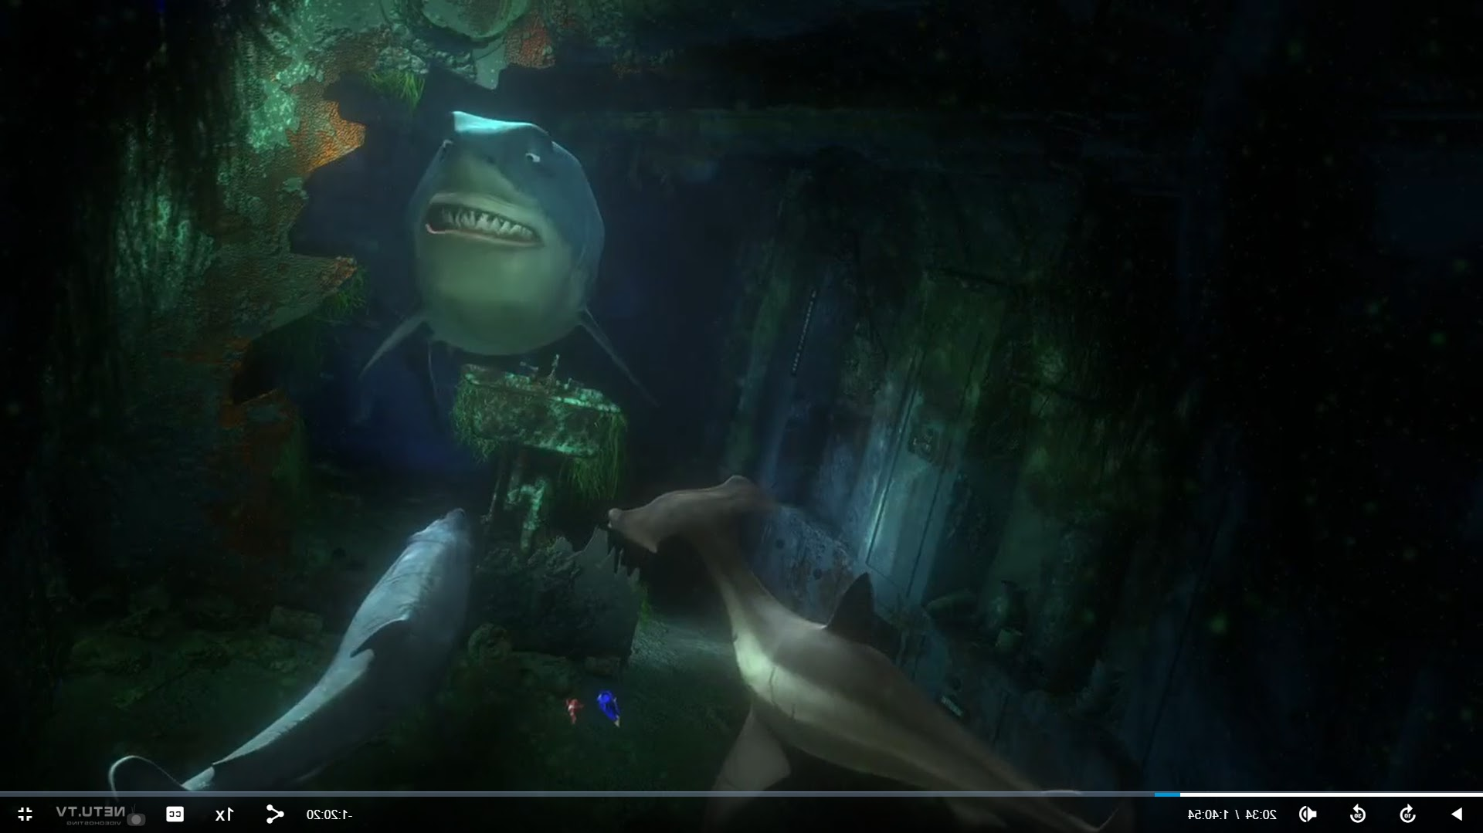
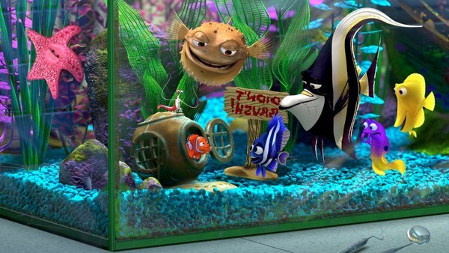
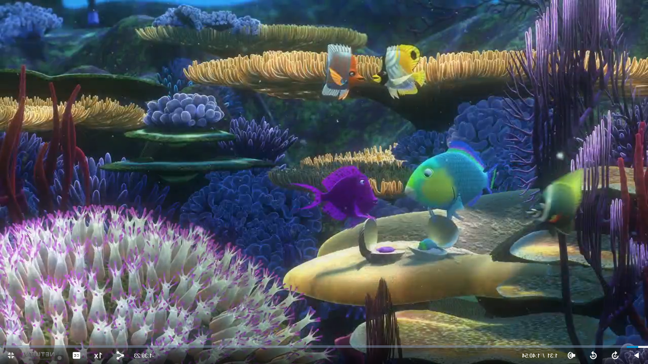
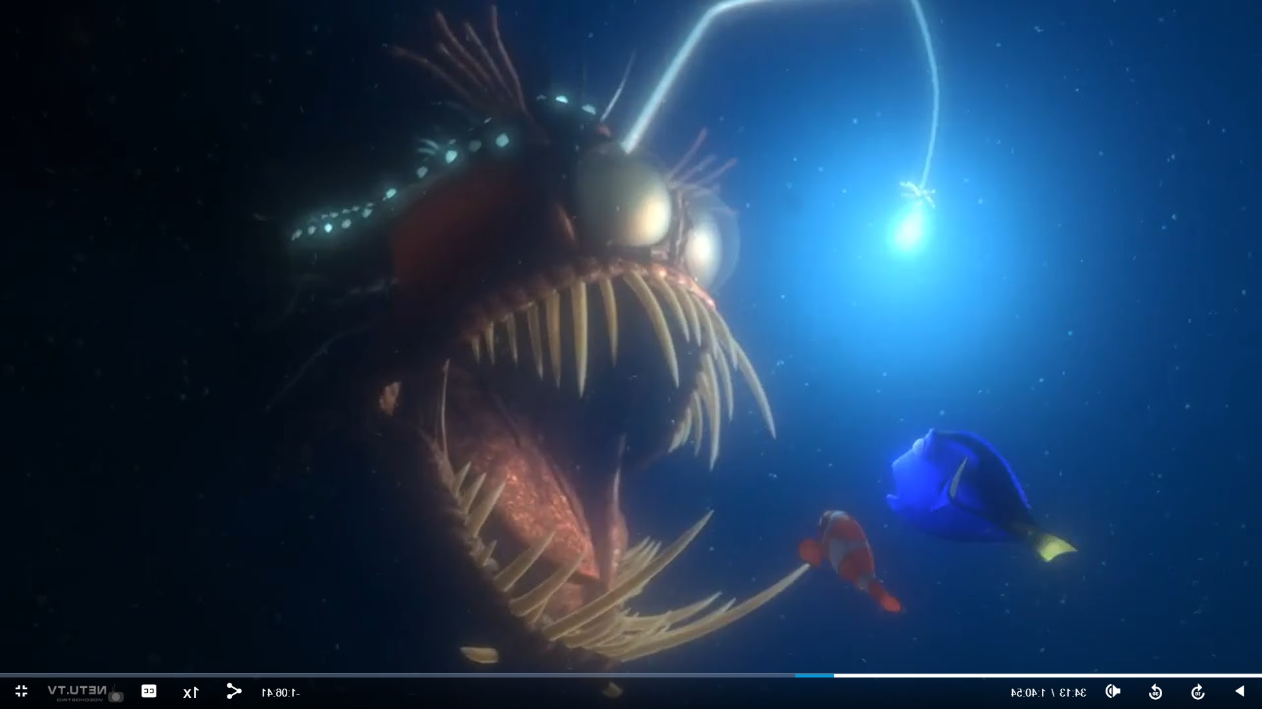
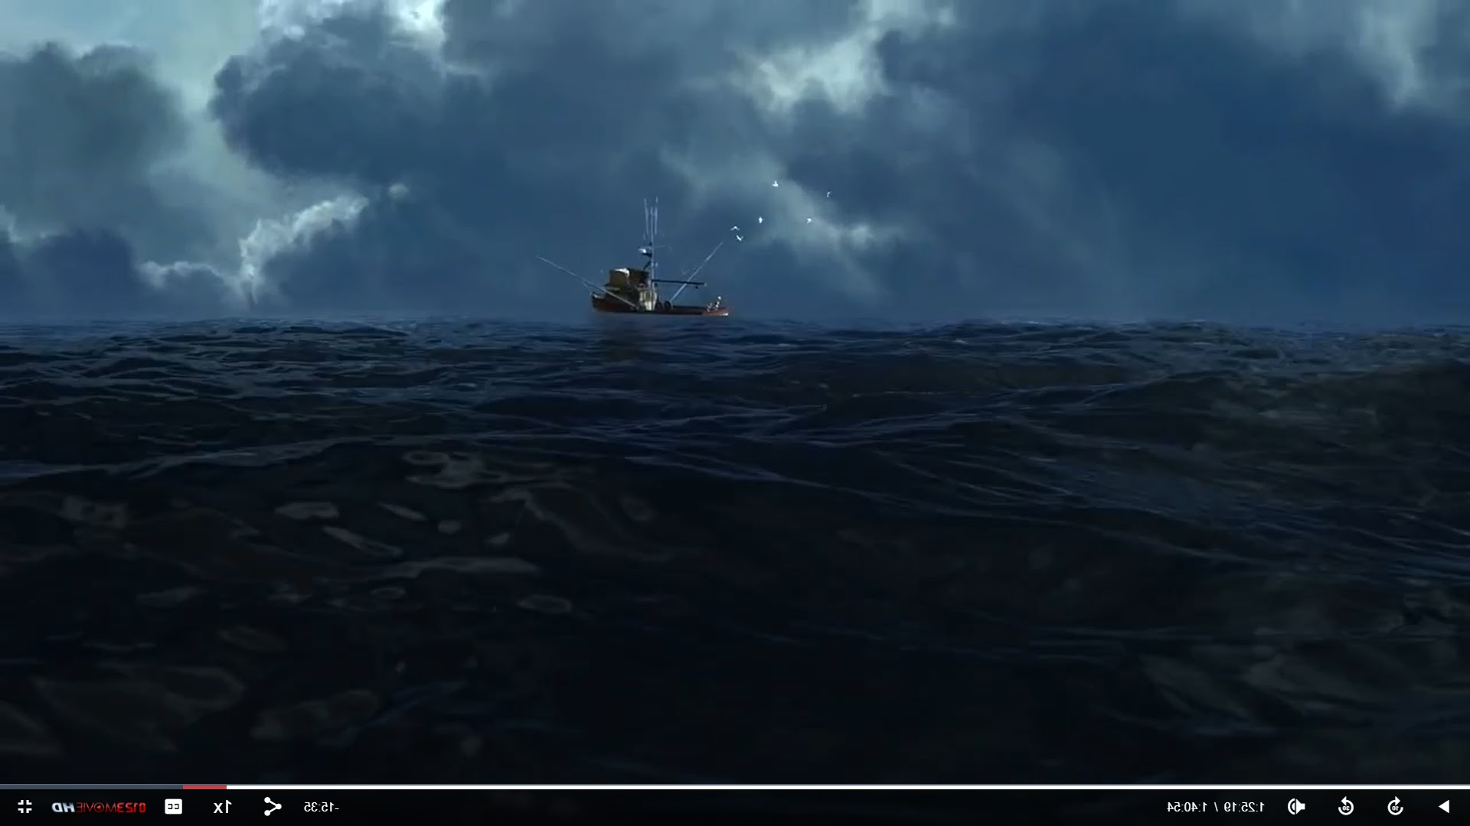
Collecting
Great Barrier Reef
East Australian Current
Recording presence/absence based on movie screenshots
Sorting the species by location in the film
Recording unidentifiable species
South Pacific Ocean
Sydney Harbour
Shark’s Lair
Dentist’s office
Trench
Fishing ground
Movie locations
Notes:
Étienne: The first step in our data collection process was, well, to watch finding Nemo. We took screenshots and recorded the presence/absence of every moving species and sorted these photos by their location in the film. We have done our best to identify all the recorded species, and we still recorded how many unknowns were left at the end of this process.

Slide 7
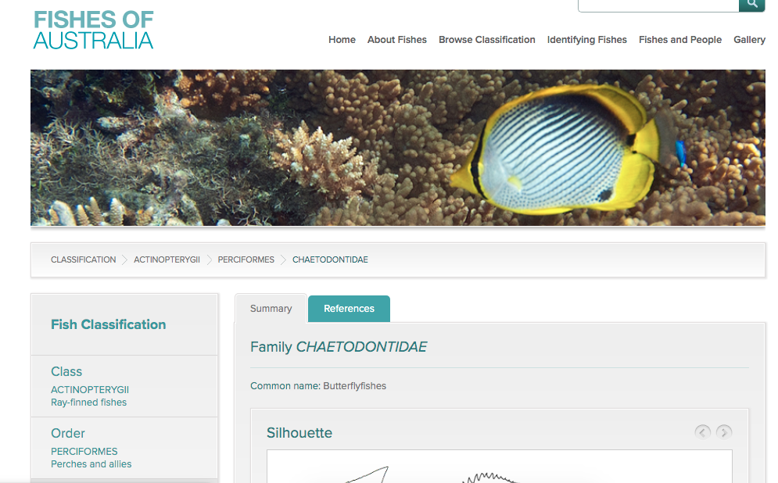
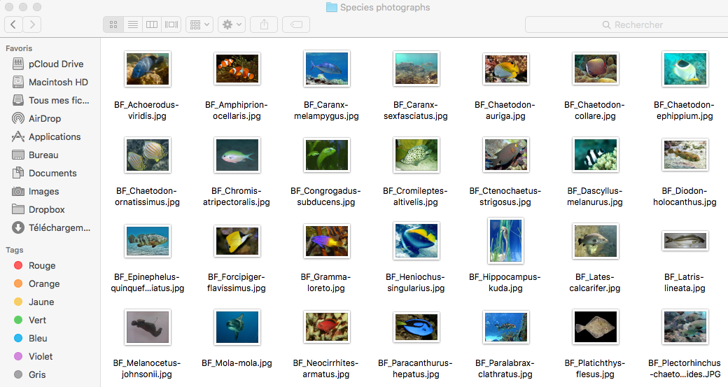
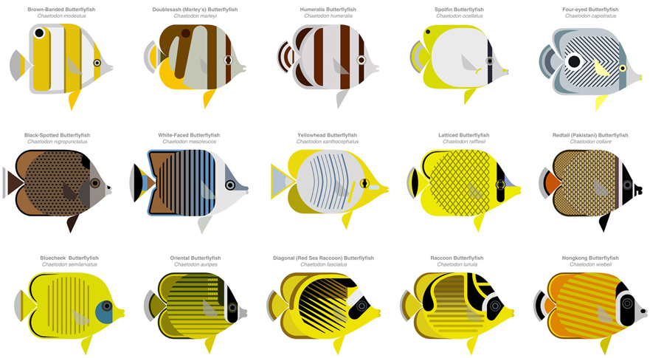
Assuring
Species identification
Fish photo reference file
Fishes of Australia website
Various resources
Notes:
Étienne: To assist us in the task of identifying the species in the screenshots, we created a fish photo reference file that included the species already identified in the movie from fan-made lists found on the Internet. We also referred to the website Fishes of Australia and other resources. But we are not experts in Australian fish identification, so we may have let some errors slip through.

Slide 8
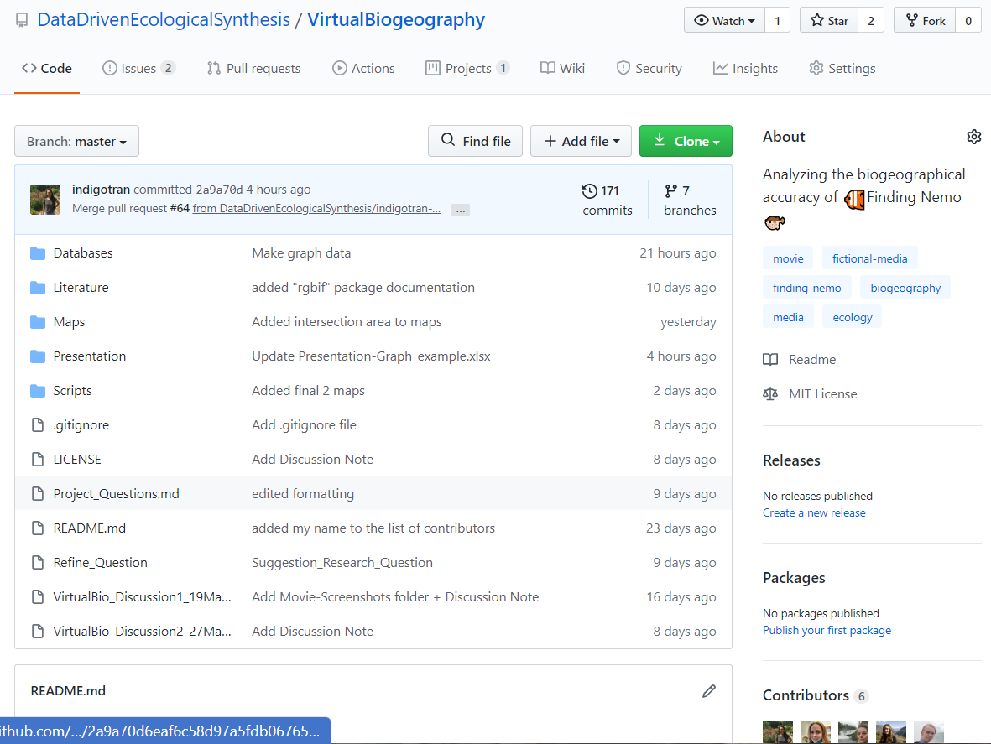
Describing
Using GitHub for remote collaboration, track changes, describe data in README, and store it
Notes:
Indigo: Because of our on-going pandemic, all of our collaborations had been done remotely. We use GitHub to host all of the collaborative content, track changes to the project, and store our detailed description of how every step of the project was done.

Slide 9
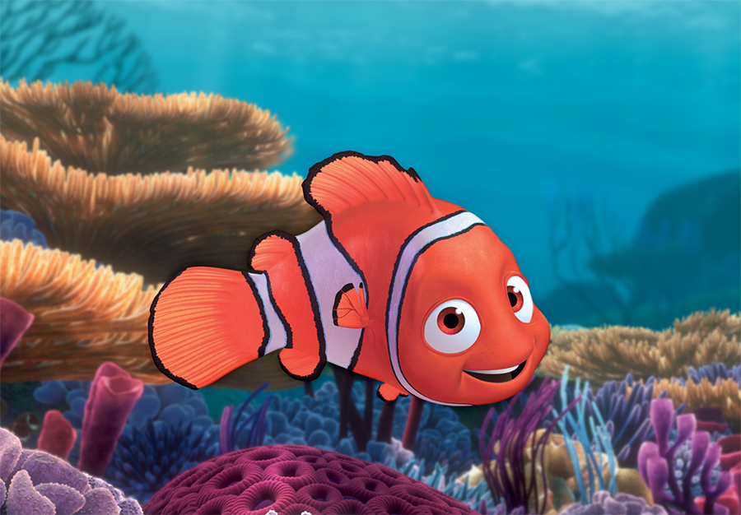
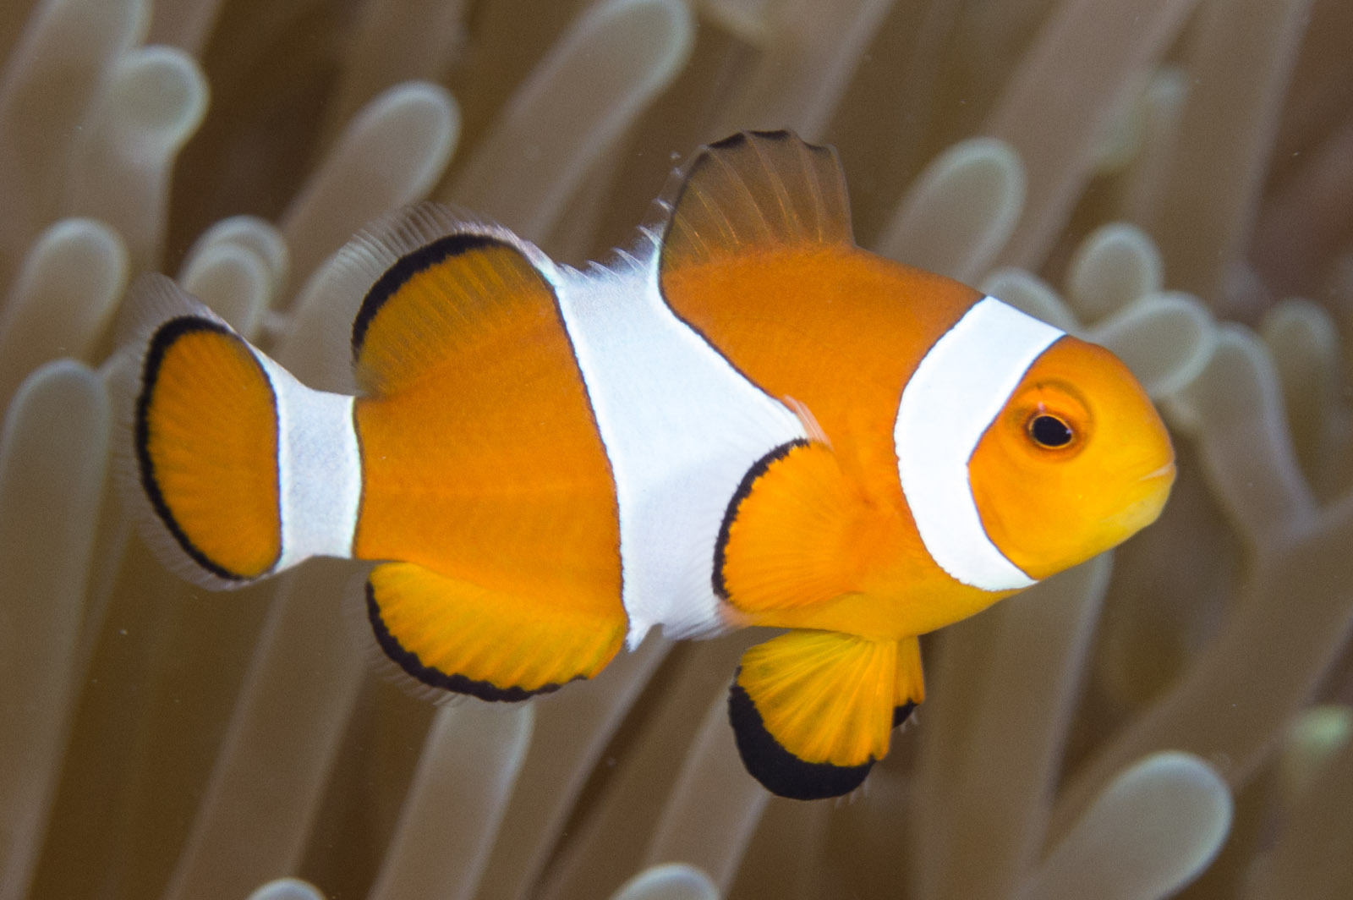
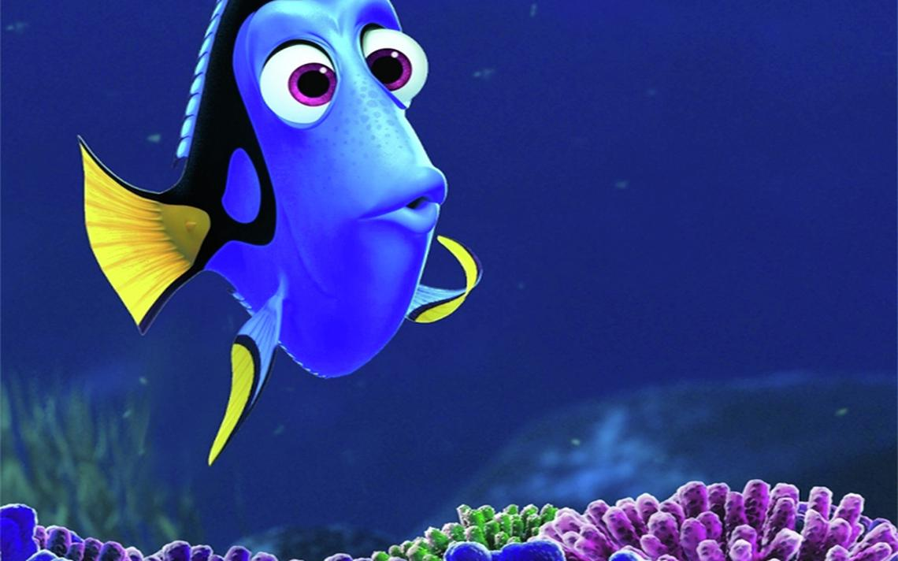
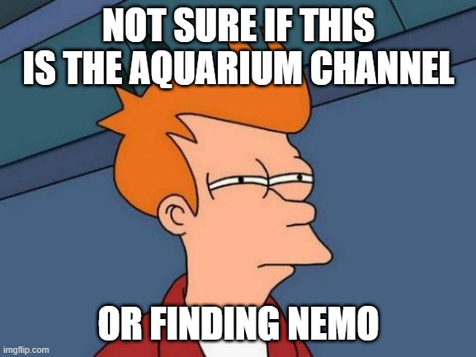
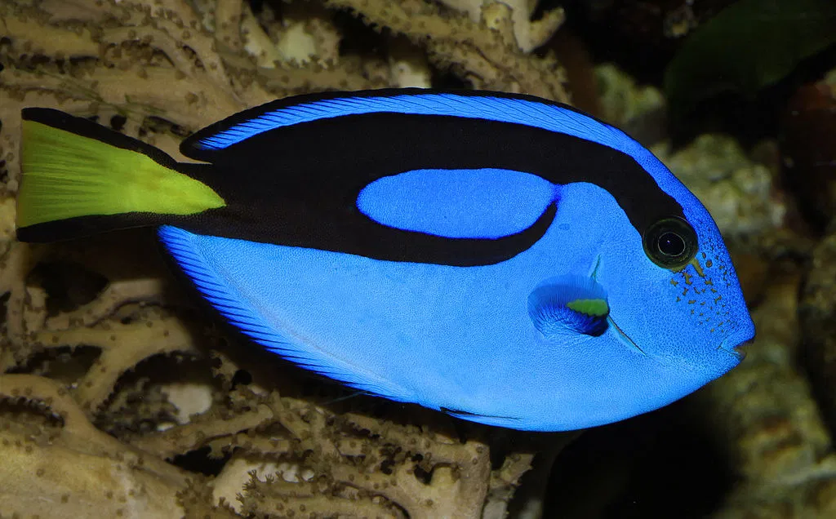
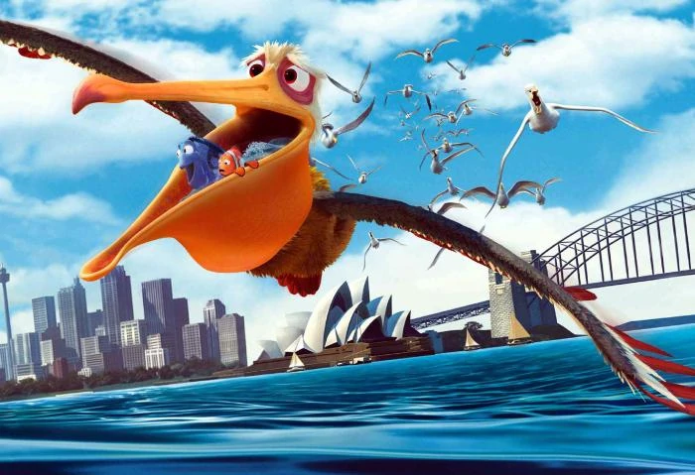
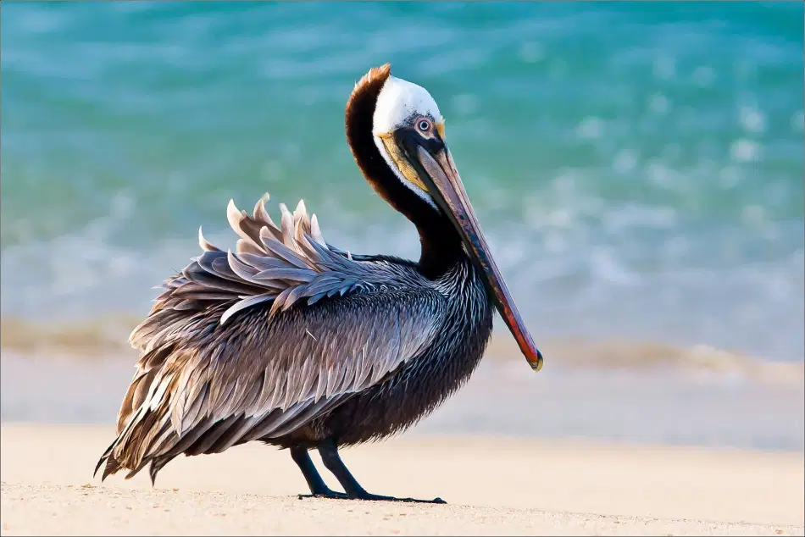
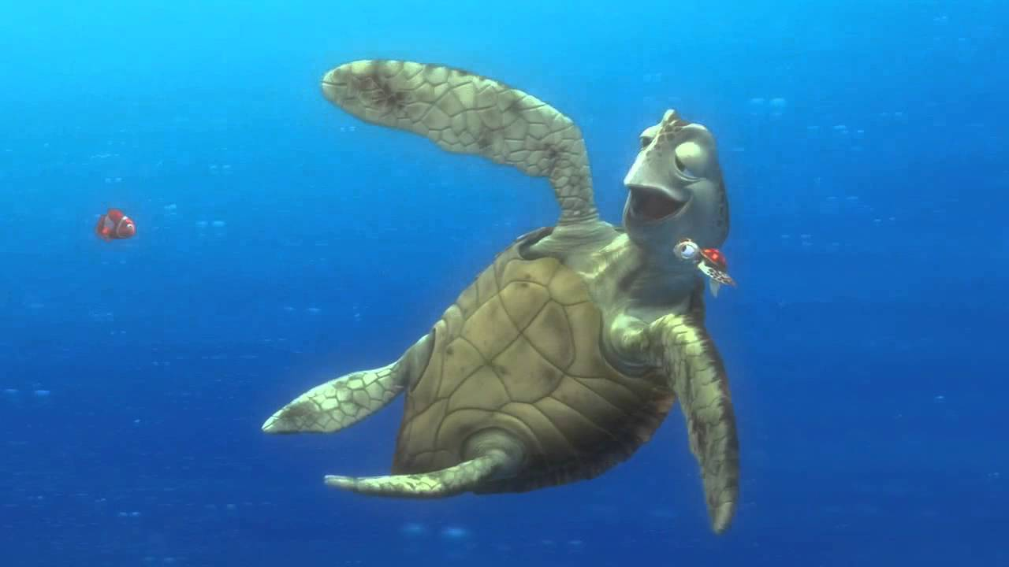
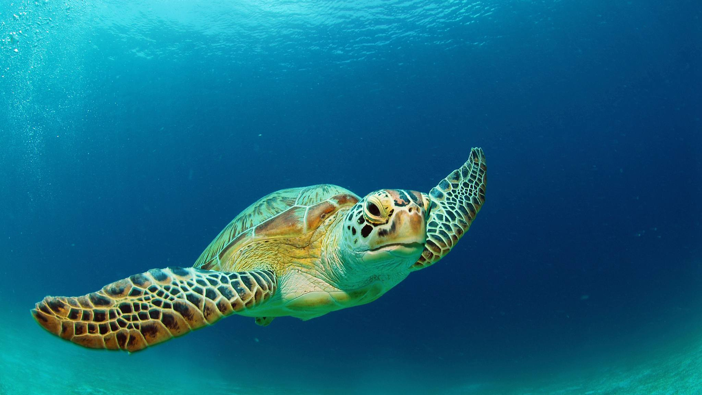
Discovering
Acquire real species occurrences to compare to our movie data
Amphiprion ocellaris
Nemo
Dory
Paracanthurus hepatus
Nigel
Pelecanus occidentalis
Crush
Chelonia mydas
Notes:
Amanda: To address our two research objectives which, as a reminder, are to test the geographical accuracy and species assemblage accuracy of Finding Nemo, we need to compare the species presences in the movie to occurrence records of character’s real life counterparts. A small sample of what some of the movie characters vs. what their real species look like are shown here.

Slide 10
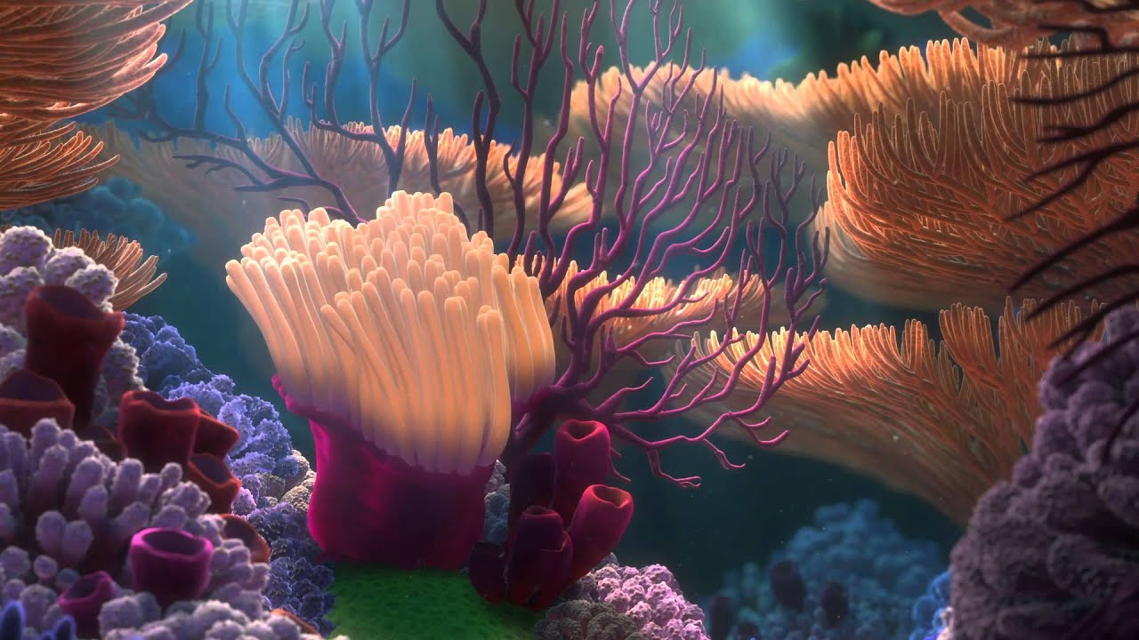
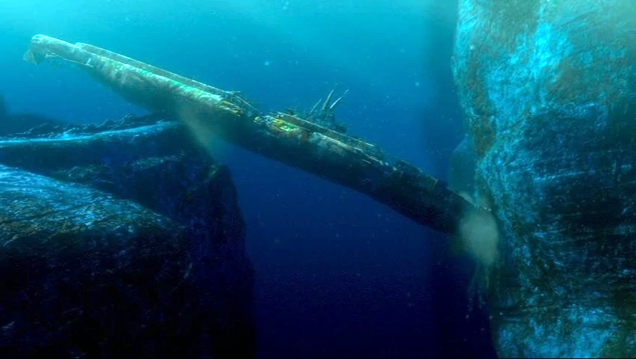
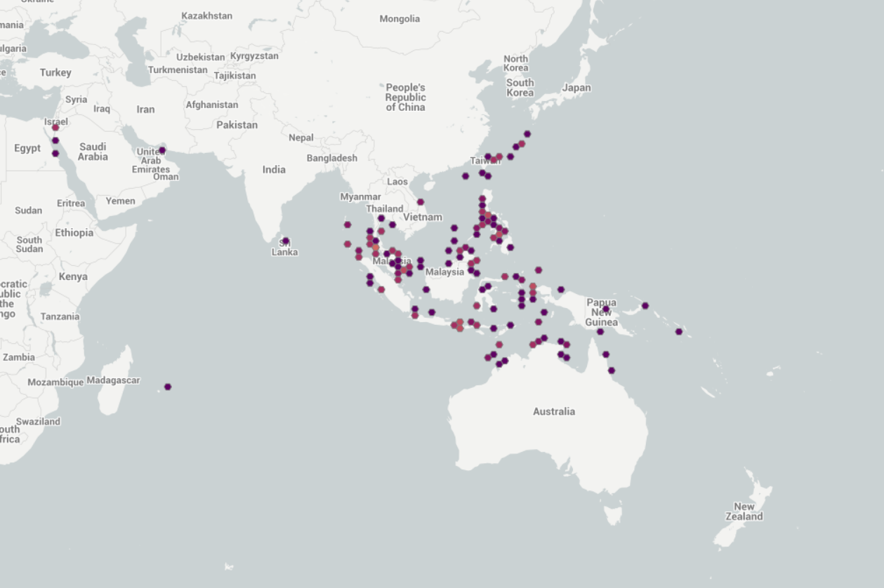
Discovering
Acquired species occurrences from GBIF by movie location
Great Barrier Reef
Shark’s Lair
Sydney Harbour
Dentist’s Office
Species
assemblages
GBIF
rgbif package
Notes:
Amanda: We acquired the real species occurrence records from GBIF or the (Global Biodiversity Information Facility). We did this by dividing up the movie species list into by movie location. There are 8 movie locations in total, here we are showing just a subset of the locations at the top of the slide to get an idea of the diversity of locations represented in the movie.
We obtained the species occurrence data for each location from GBIF using the R function “rgbif”. This function allows you to access GBIF occurrence data through the GBIF API.

Slide 11




Assuring
Records with Latitude & Longitude
Checked species synonyms
Clean occurrences
RBGIF
OpenRefine
Raw occurrences
RGBIF
OpenRefine
Records with no geospatial issues
Incorrect species removed
Notes:
Amanda:
Whenever you acquire data, there is likely some data processing or data assuring required, and this is true for GBIF species occurrence data.
Here is a flow chart outlining our data assurance process.We started with the raw occurrence values on GBIF for our species assemblages and removed occurrence records where latitude and longitude were missing, and any records that had geospatial issues. An example of possible geospatial issues are latitude and longitudes that were reversed when the data was input.
These initial data cleaning steps we did right away with the rgbif function.
Next we cleaned up the species names in our datasheet. We did this by updating species synonyms to the current accepted species name and removed any incorrect species.
Examples of incorrect species include species that were pulled from GBIF by mistake (this sometimes occurred when similar species, like those in the same genus, were also pulled from GBIF). All species name corrections were performed using OpenRefine.
And now we have our clean dataset.

Slide 12
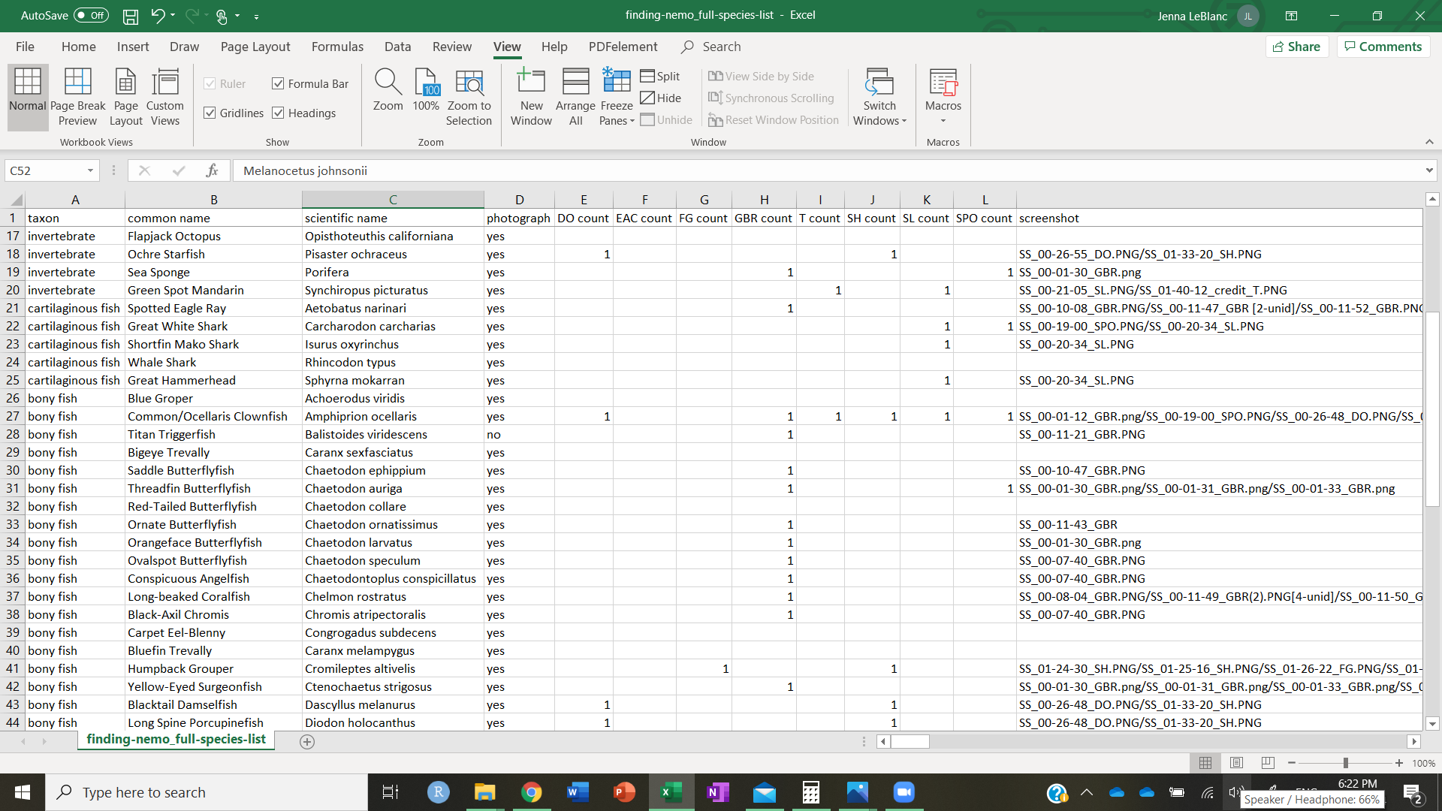
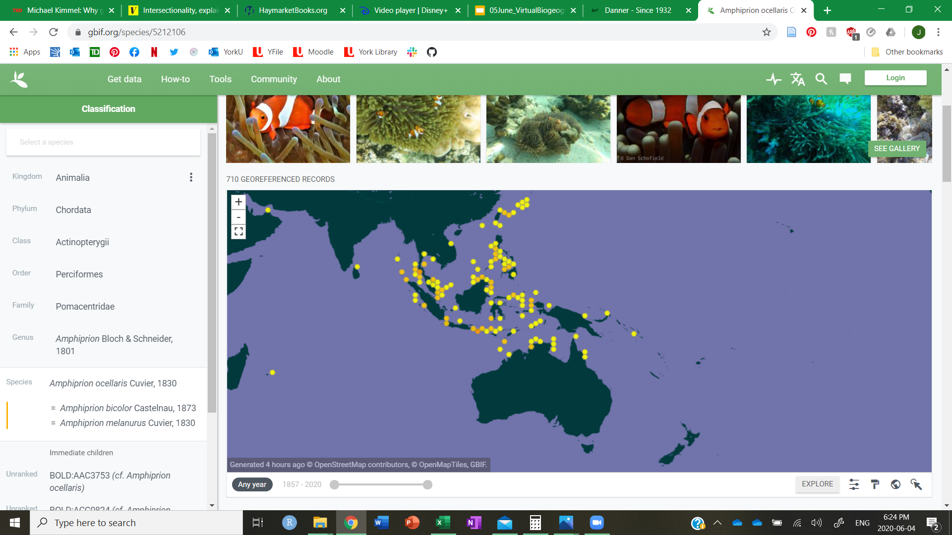
Integrating
Integrate
Data collected from movie screenshots
Biogeographical Accuracy?
GBIF occurrence data
Notes:
Indigo: The species list determined from the movie was used to inform which species occurrence data we can pull from GBIF. So after the collection, we combined data from the movie screenshot with the occurrence data from GBIF into a master database to assess for the movie’s accuracy.

Slide 13
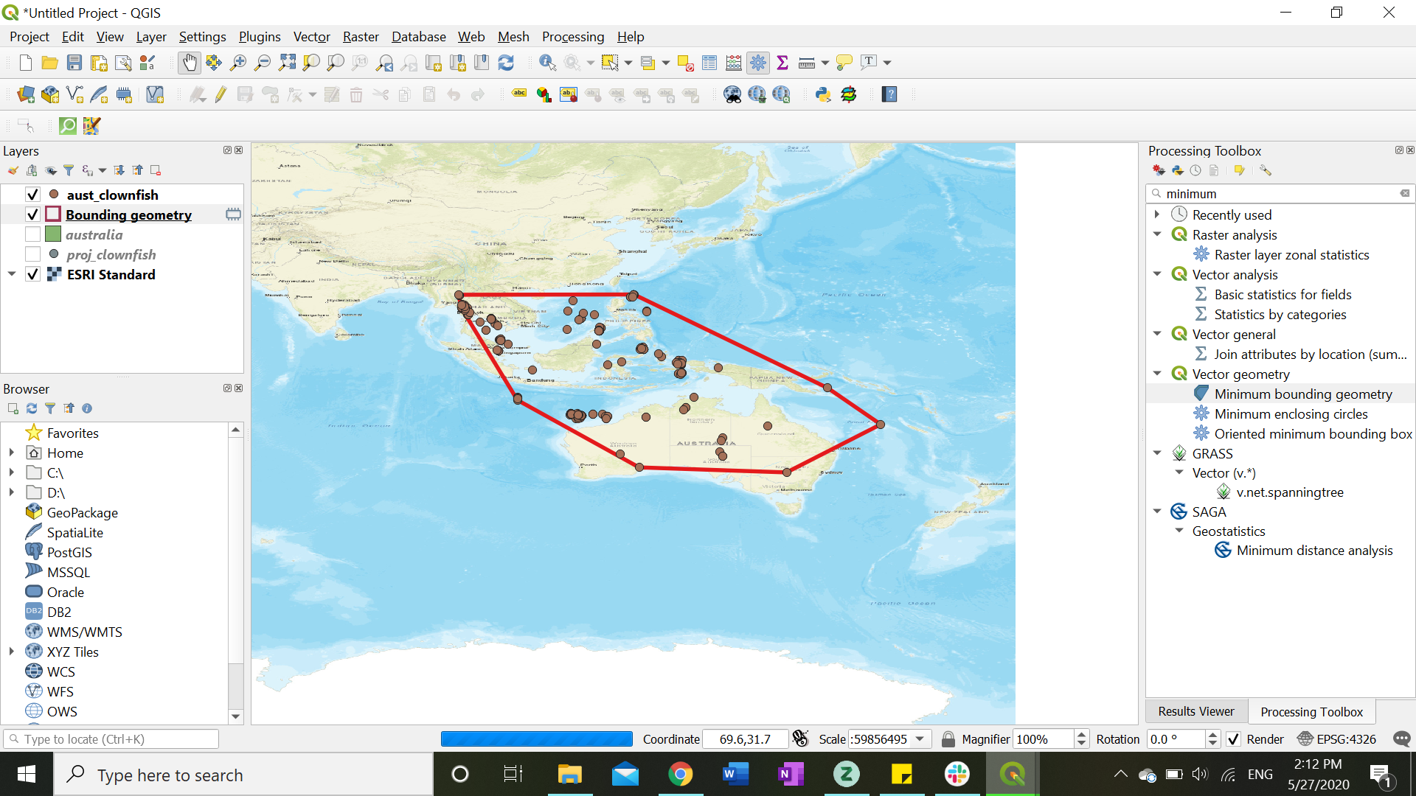
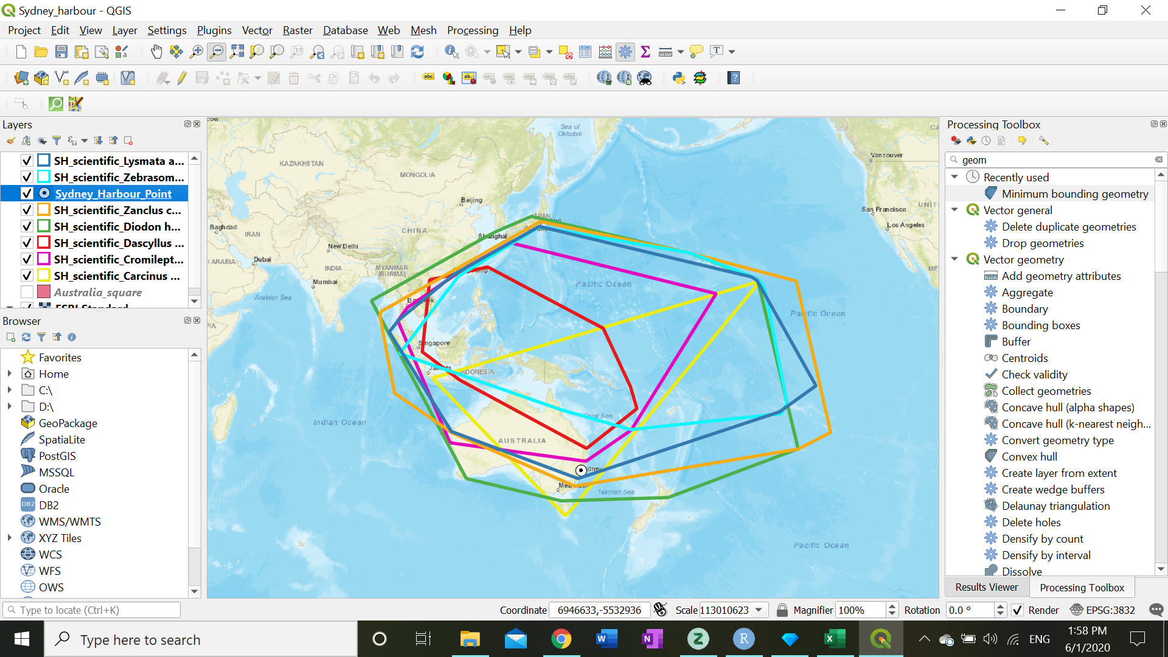
Analysing
Lat | Long
25S | 133E
Translate Lat/Long into points on a map
Generate a polygon around the points belonging to a single species
Repeat process for every species shown in the same location
Notes:
Emily: What we ended up having from the GBIF records was a list of latitude/longitude coordinates for each species observation. We mapped these coordinates in QGIS to show the location where the observation occurred visually. We then generated polygons around the points for each species using the minimum bounding geometry tool. All the species that were shown as an assemblage in the movie were placed on the same map to check for overlapping ranges.

Slide 14
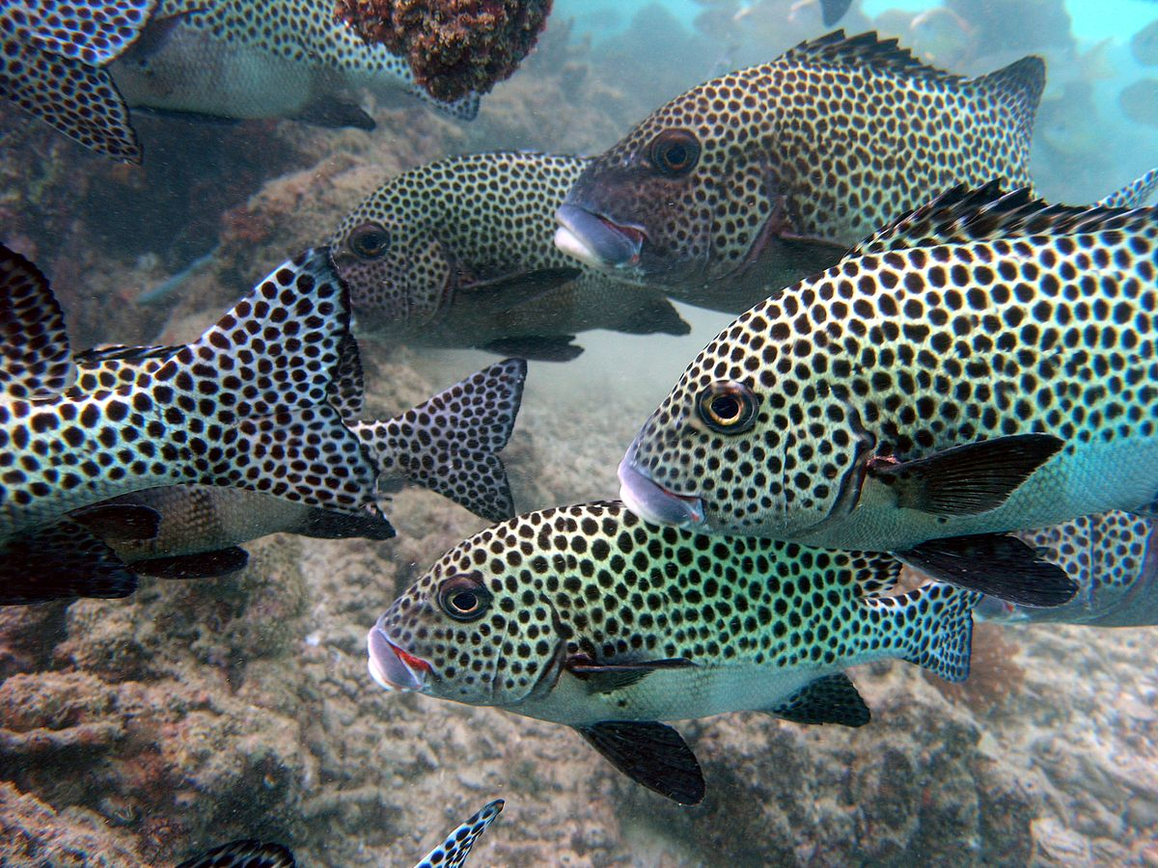
Results
Notes:
Indigo: So now the part you’ve all been waiting for: Do the species depicted in Finding Nemo live up to the expectation of our childhood?

Slide 15
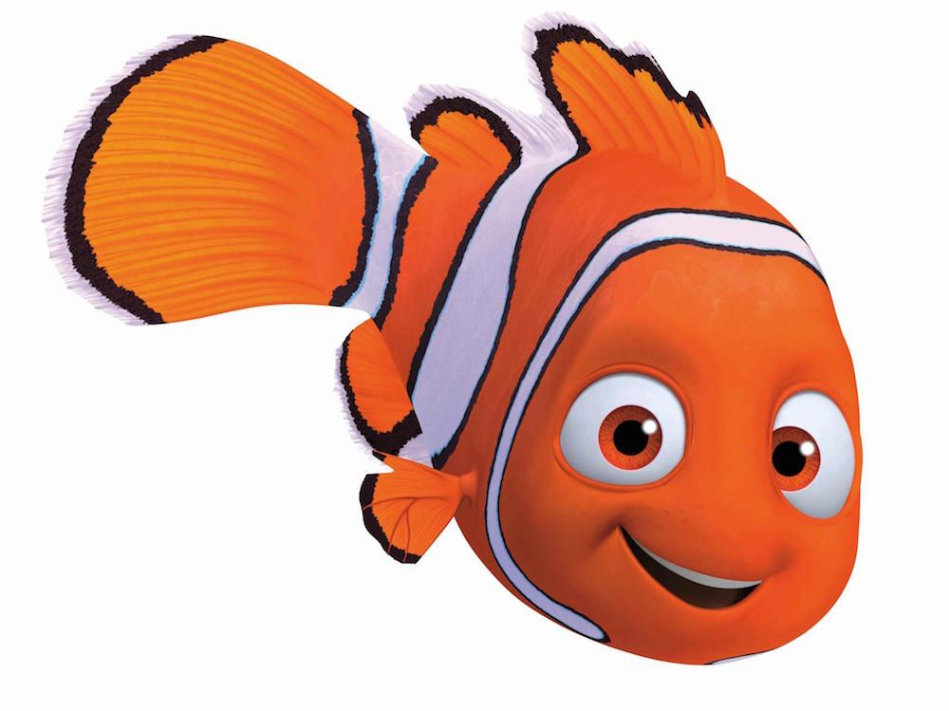
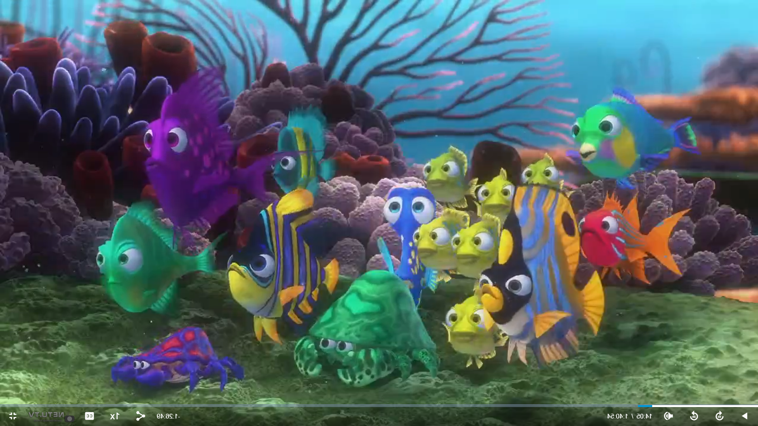
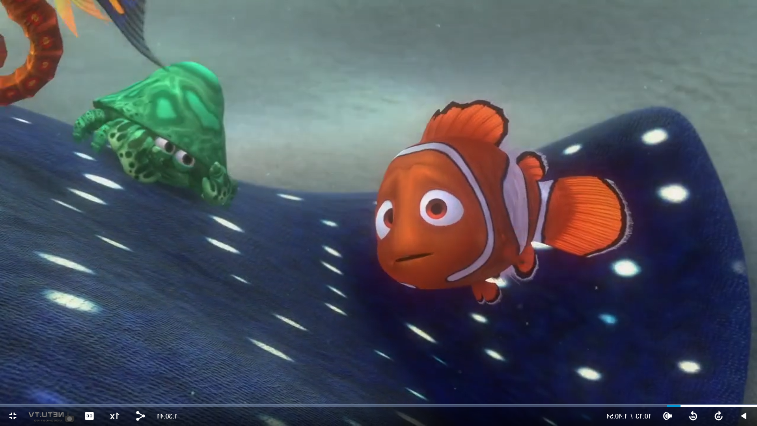
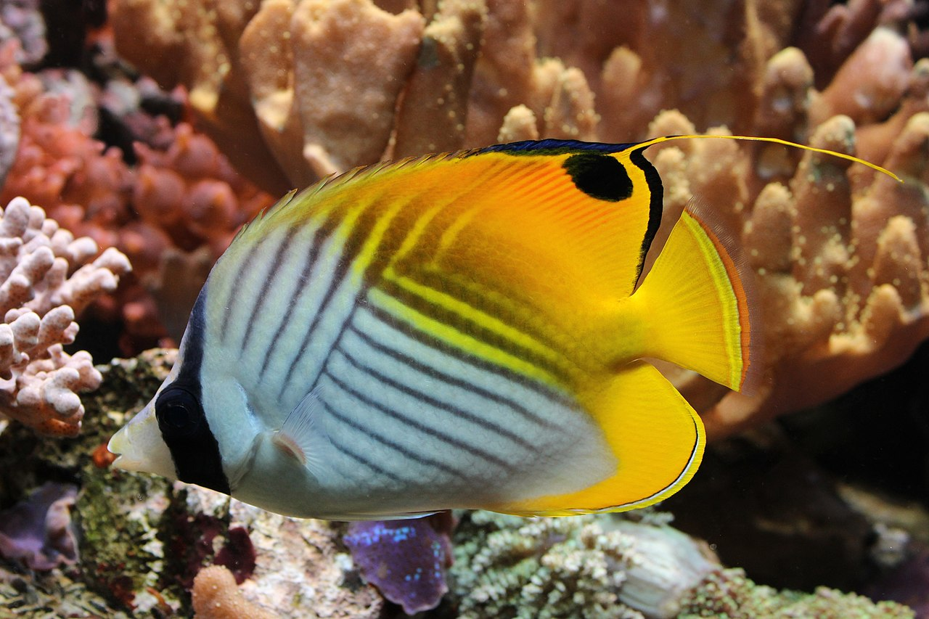
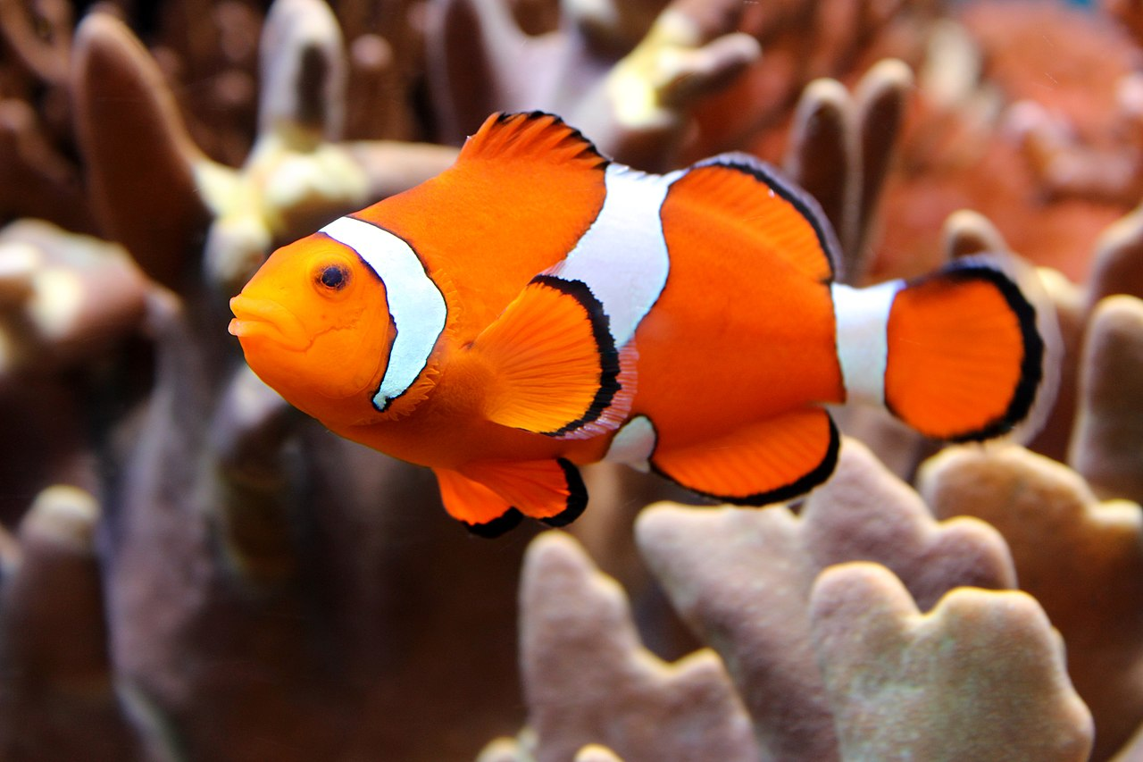
Species depictions
?
Notes:
Indigo: When we say species depiction, we mean whether it is drawn close to the source material, like Nemo as a clownfish, or it took some guess work like in the case of this butterflyfish where the artist definitely took some deliberation on how to depict a real species, or in the case of this green crab where we could not find a real life counterpart to match.

Slide 16
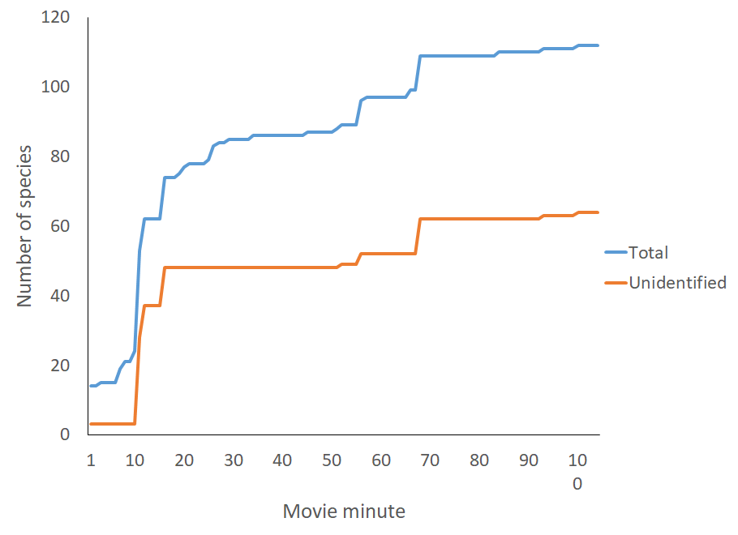
Accuracy of species found in Finding Nemo is only at 57%
Notes:
Indigo: So this is a line graph showing the number of species counted in the movie by the movie minute. The blue line is showing the total number, while the orange is the unidentified or generic species that can not be match with a real life counterpart. Out of 112 species in the movie, 64 were unidentifiable, or in other terms, only 57% of species where biologically accurate.
Now let’s talk about how the movie fair out geographically.

Slide 17
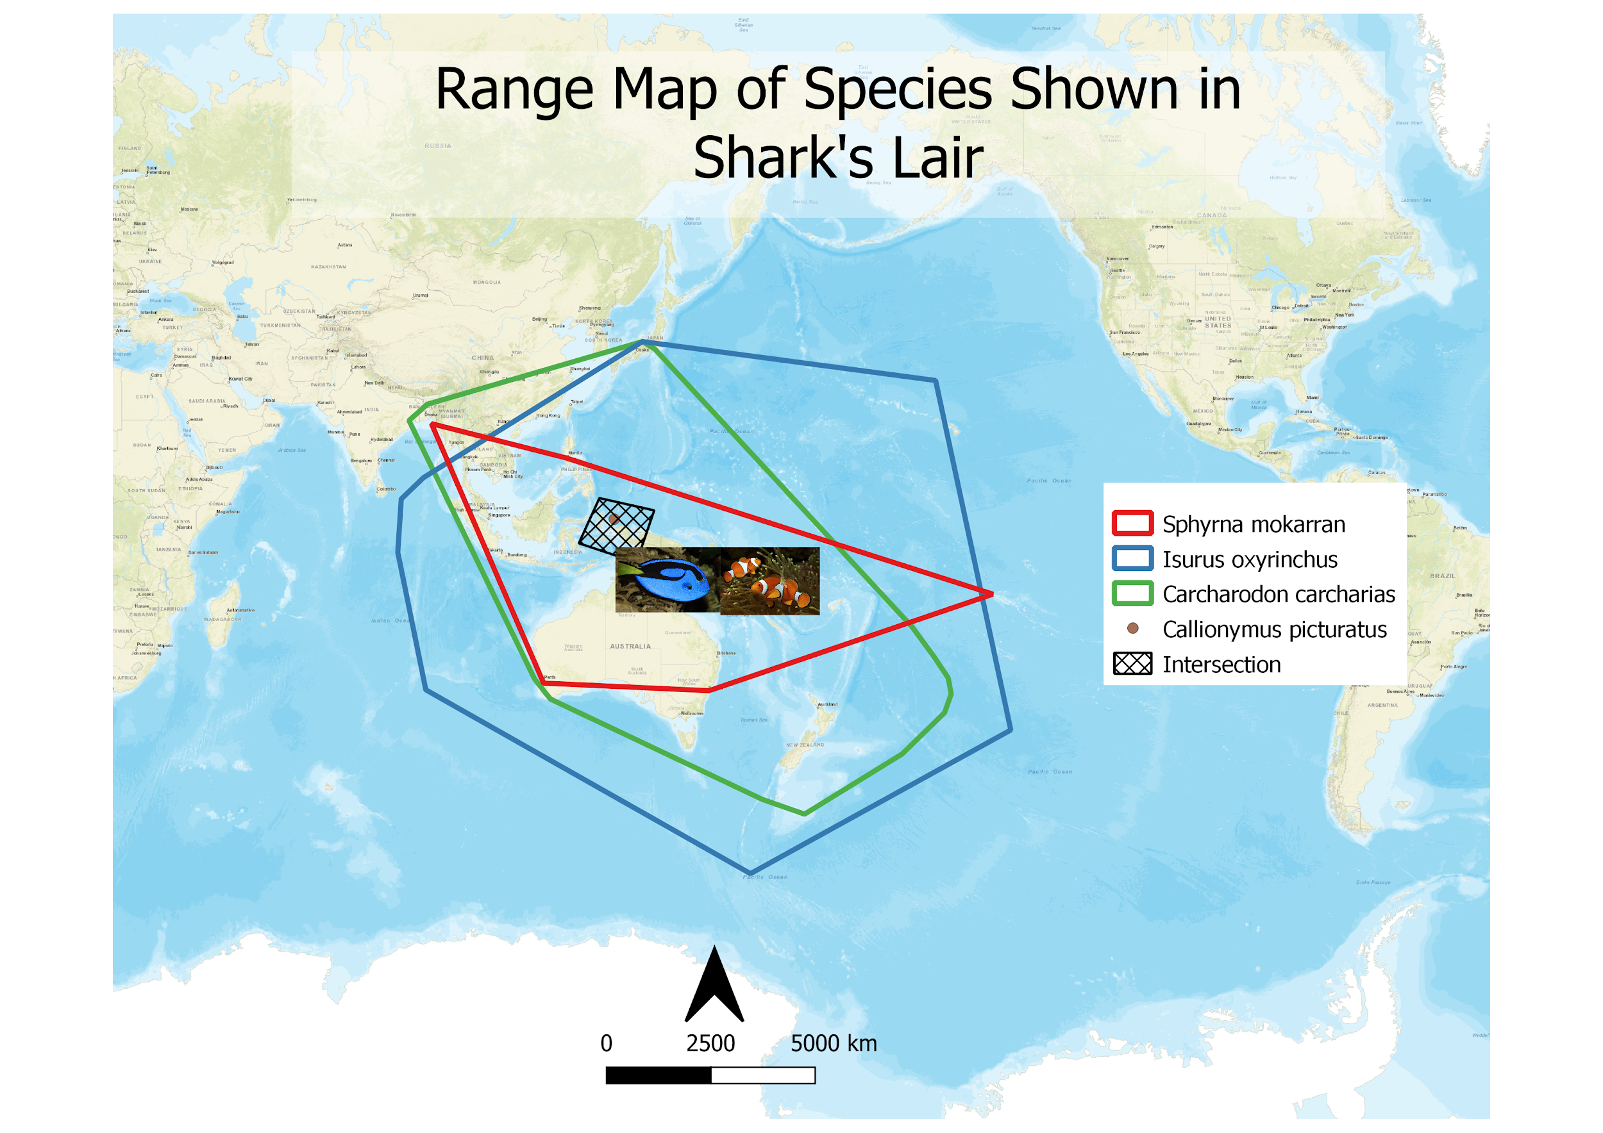
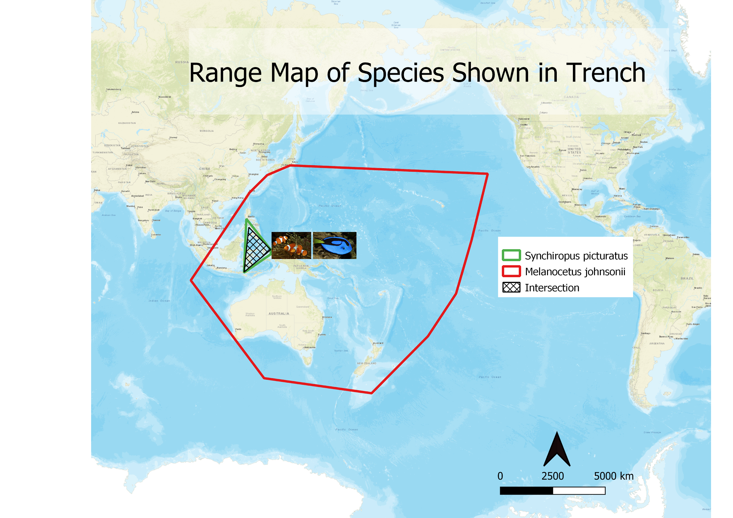
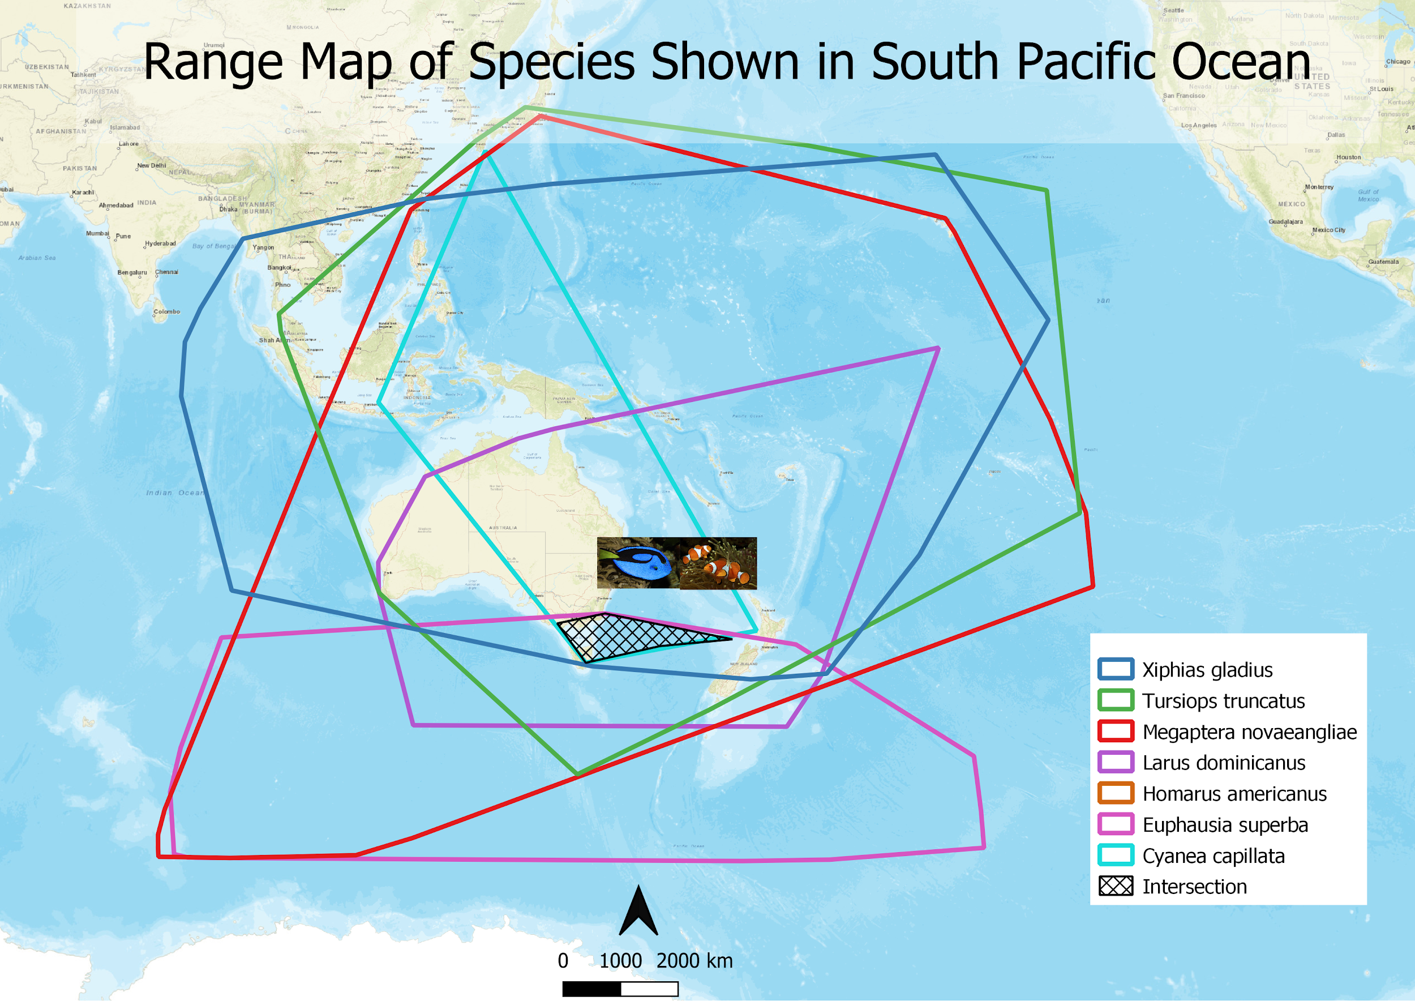
✅
Notes:
Emily: Many of the species assemblages portrayed in the film did turn out to be accurate. The examples shown above get an A for accuracy

Slide 18
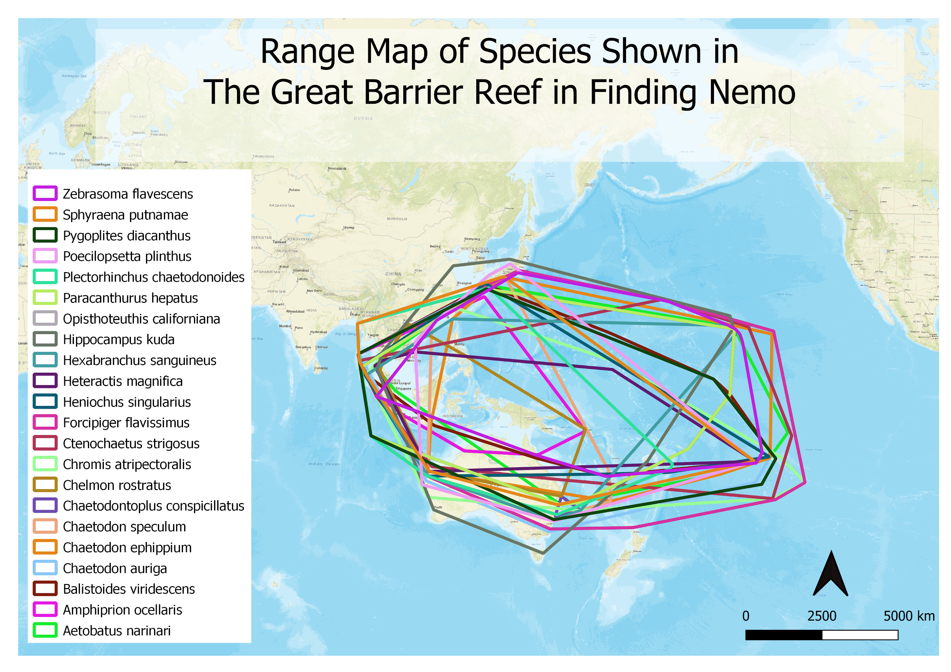
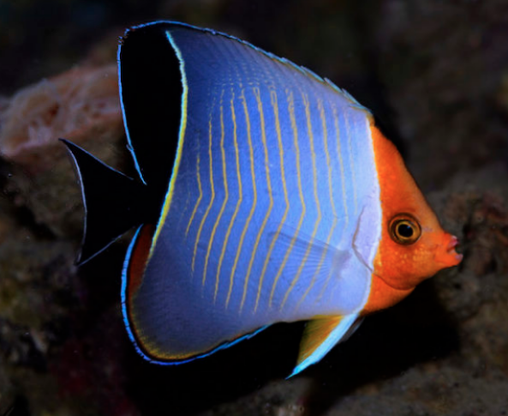
Notes:
Etienne: Other assemblages shown in the film were a bit less accurate though. The Reef was by far the most species-rich location in the film, and the distribution areas of most of these species were in fact overlapping in an area that is within the actual limits of the Great Barrier Reef in Australia. (next slide)

Slide 19
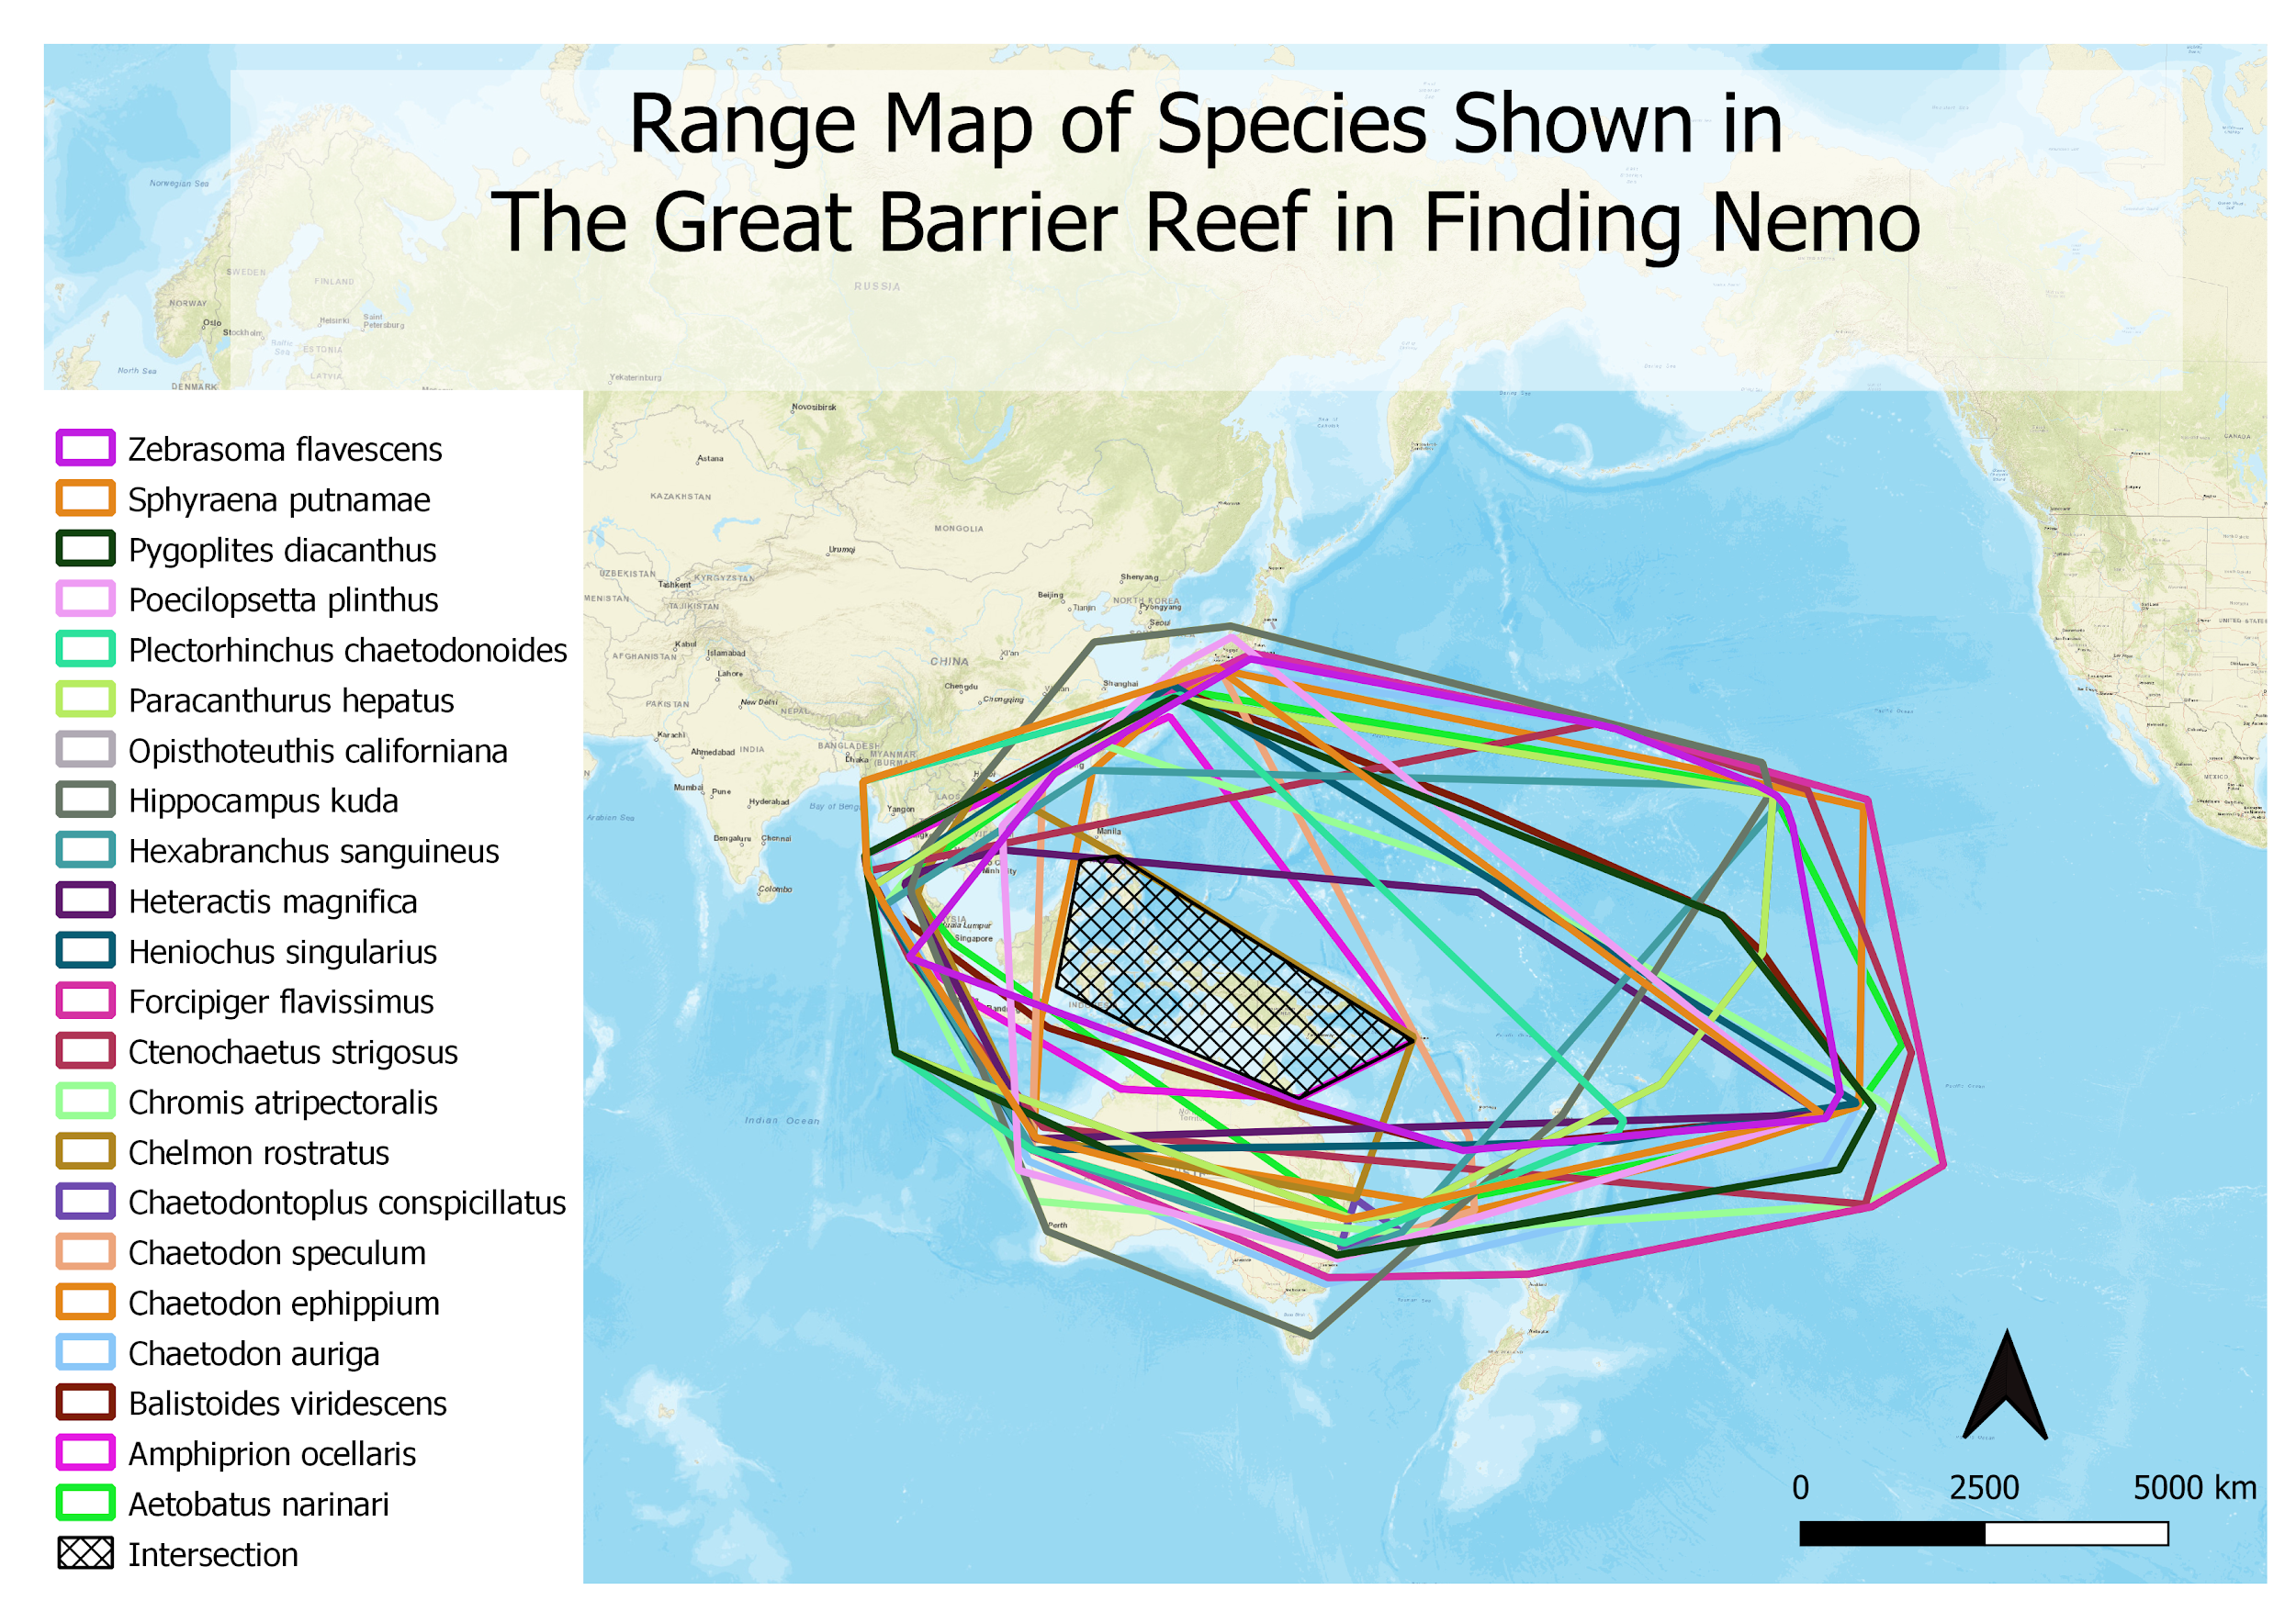
Doesn’t live near Australia
Notes:
Etienne: As is shown here. However, some species depicted in this part of the movie, like the red-Faced Butterflyfish, don’t occur anywhere near Australia. In fact, that species in only found in the Red Sea and the Gulf of Aden near the coasts of Africa. So, this assemblage lacks a bit of accuracy. (next slide)

Slide 20
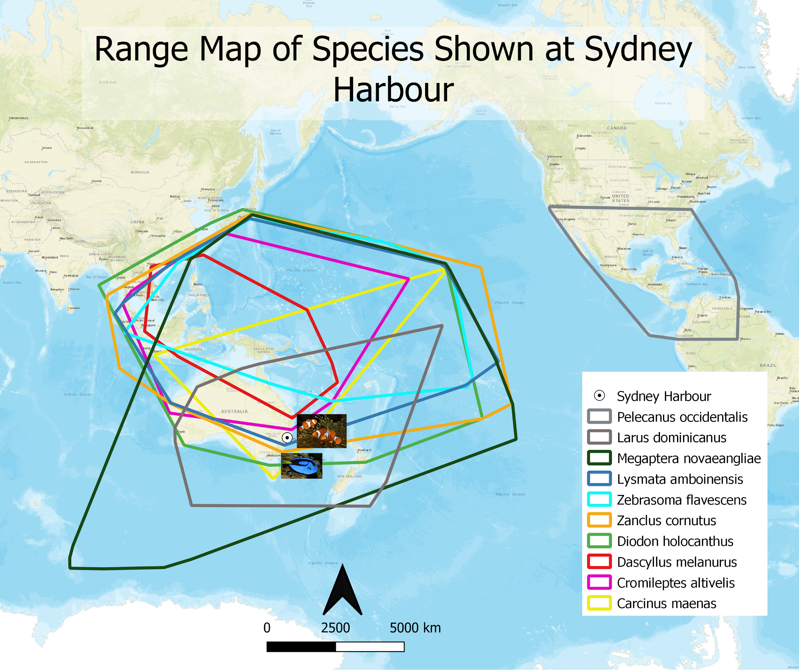
Notes:
Emily: At the Sydney Harbour there were 2 major mistakes (next-slide)

Slide 21
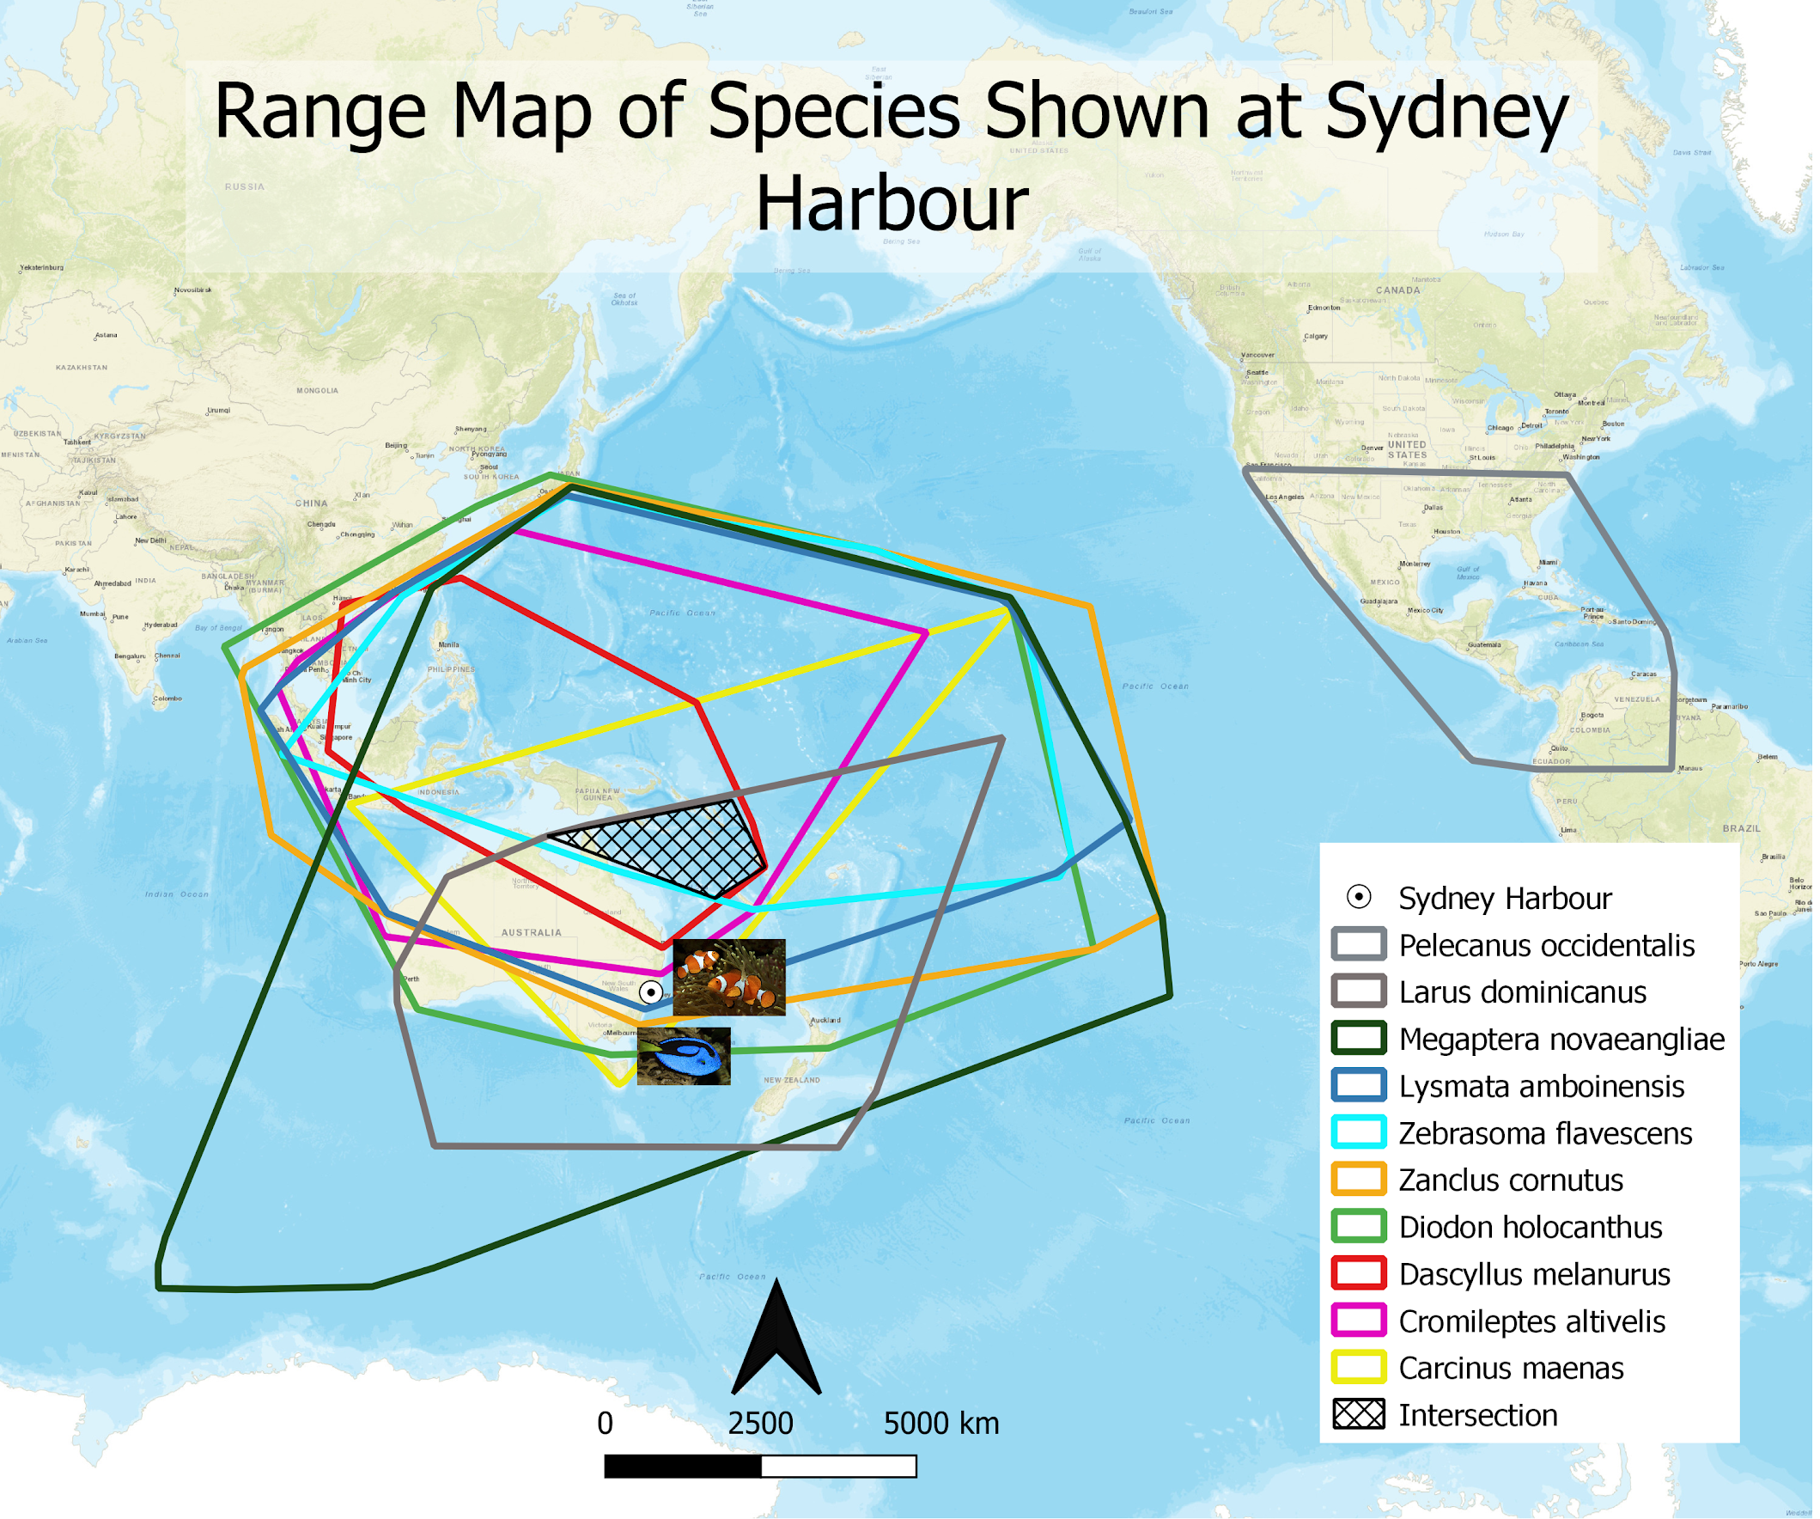
Not Australia
Notes:
Emily: The area where all these species overlap is not near Sydney Harbour. Some of the species portrayed in this film live too far North to have been at the location they were depicted in for this scene. There was also the issue that the Brown Pelican depicted in the film does not live near Australia at all

Slide 22

Notes:
Emily: Based on the small areas where all species overlapped on each map, we were able to map the approximate route travelled by Marlin and Dory. For the most part this route is quite logical, except that the Deep Trench, where Marlin and Dory visit near the beginning of the film would have required them to travel along the North Coast of Australia, rather than South towards Sydney. We can tell this because the species of fish portrayed at the Trench do not live further South than the North Coast of Australia. We give the this map a B for biogeographical realism. (next slide)

Slide 23




Report Card
Name: Finding Nemo
Evaluated by:
DDES-Virtual Biogeography Team
Category | Grade
Species depiction | B+
Spatial accuracy | C
Enjoyability | A+
Grading scale
A = C =
B = D =
Notes:
Indigo: So in conclusion, we gave a letter grade to the efforts made in Finding Nemo. B+ for species depiction, only a C for spatial accuracy. But despite the inaccurate bio-geo-graphical depiction, you can still enjoy the movie when you take off your biologist hat.
Image source:
Dory: https://www.pinclipart.com/downpngs/iRmToTT_download-hd-png-image-transparent-background-finding-nemo/

Slide 24










The (Tank) Gang
Dr. Poisot | Emily Kroft | Étienne Lacroix-Carignan | Jenna LeBlanc | Amanda Liczner | Indigo Tran
Notes:
Indigo:
I want to thank all of our collaborators for their wonderful work and commitment to the project, the tank gang! And gratitude towards all our instructors and our classmates for their valuable contribution.
And if you want to replicate the framework that we used here to assess Finding Nemo, and apply it to another piece of media, we have all of our data and code on a GitHub repository with an MIT license. You can contact any of us for more information.
Image sources:
Gill: https://www.seekpng.com/idown/u2q8t4e6u2t4t4w7_finding-nemo-characters-png-gill-from-finding-nemo/
Nemo: http://www.pngall.com/nemo-png
Deb/Flo: https://www.jing.fm/iclipt/xxxhbR/
Jacques:https://findingdory.fandom.com/wiki/Jacques
Bubbles: https://www.clipartkey.com/view/iRJmxmm_bubbles-gurgle-philip-sherman-mr-bubbles-from-finding/
Peach: https://www.hiclipart.com/free-transparent-background-png-clipart-dzkur

Slide 25

Personal story
Emily’s Finding Nemo GIS folder
Notes:
Emily: Something that our group that would be fun to share is that when I first started learning GIS in my undergrad, I kept all my homework in a Finding Nemo folder, and the very first assignment I ever had to do was to digitize a map of Australia. So when I realized I would now as a grad student be doing a GIS project about Finding Nemo using a map of Australia that felt like a really funny way to come full circle in a way that I really didn’t expect.

Slide 26
Q&A

Slide 27





Data Overview
Great Barrier Reef
Trench
Brown pelican
Green spot mandarin
Notes:
Amanda:
Here is a quick overview of what our dataset looks like.
All together we had 41 different species that made up over 440,000 occurrences.
The 41 species came from 6 different classes.
The most species diverse movie location was the Great Barrier Reef, and the least diverse was the deep sea Trench.
The species that had the most records was the Brown Pelican, or Nigel from the movie, and the species with the least records was the green spot mandarin or “Blenny” from the movie.

Slide 28





Difficulties we faced while collecting
Ambiguous species
Nonexistent species
Mislabelled species names
Species absent from the fan-made list
?
Notes:
Difficulties we faced while collecting
Ambiguous species
Nonexistent species
Mislabelled species names
Species absent from the fan-made list

